Slide 1
WOW
Notes:
wowowow
Hello everyone
Thank you for studying computer architecture with me.
When you were deciding to choose this class, or any class, what did you expect?
The more I teach, the more I feel that, what a class delivers should not be limited to the knowledge covered on the textbook. It can also be exciting, interesting, and rewarding in many possible ways.
Somehow, I consider that all of those possible aspects can be summarized using this word.
It’s sort of like a feeling that you relate yourself to various scenarios of the class. For example…
Or even years after you’ve taken the class, whenever you happen to think of this class again, you may still get this feeling.
And this, is exactly the ultimate goal of our computer architecture class.

Slide 2
Finally, Computer Architecture!
01
Notes:
Thank you for studying

Slide 3
Computer Architecture!
Notes:
this very challenging hardware course with me.
First, let me ask you some questions. Which hardware courses did you complete?
What did you learn in those courses?
How about software courses?
It’s great to know that you have already built a solid background of computer science.
But as you may or may not have noticed, when you learn the software courses, you follow a top-down approach

Slide 4
Computer Architecture!
program
Notes:
At first, you started with various programming languages, like C and Java.
Through those courses, you might have developed some fancy programs/applications and become very much amazed by how awesome our computers can be.
And hopefully, you might’ve also accumulated a strong interest in computer science.
After a while, you might have become more curious about how exactly your programs are handled by computers.
For example, when you open a file or print a string on the screen, you simply call a function like OpenFile and Print, but you don’t need to worry about how to implement the called functions.
Instead, standard libraries of the programming language in use do that for you.
Meanwhile, you may have noticed that when you install certain sdk on your computer, you usually need to choose a specific version that suits your operating system.

Slide 5
Computer Architecture!
program
operating system
Notes:
So, operating system is a special program that manages other programs.
First, an operating system provides necessary support for function implementation in Libraries. For example, the OpenFile function implementation in Library may further call a function defined in the code of the operating system.
More importantly, an operating system manages computer hardware and software resources and provides common services for computer programs. For example, many tasks may be running on our computers. It is the operating system that decides which task accesses which resources at which time instance.

Slide 6
Computer Architecture!
program
operating system
digital logic
Notes:
When you study the hardware courses, you followed a bottom up approach.
You probably started with Digital Logic, which models computer computation at a very low level.
For example, how information is modeled by signals in a binary fashion, how a single transistor represents a bit, how a gate achieves simple operations over a combination of transistors;

Slide 7
Computer Architecture!
program
operating system
organization
digital logic
Notes:
apparently, it is challenging to always break up a complex computation into sub-computations supported by digital logic
That’s why you get to know more computation units in the course of computer organization.
In computer organization, you also learned other components like CPU, memory, and I/O, that are indispensible for computation.
So far, there is still one major question left unresolved: how exactly do these computer components cooperate to complete a computation?

Slide 8

Computer Architecture!
program
operating system
organization
digital logic
Notes:
In the course of Computer Architecture, you will reveal this missing piece.
As shown in the slide, computer architecture is a layer between software and hardware
It is an Architect/microarchitect’s view of how to design a computer that meets system design goals;
Design choices critically affect both the software programmer and the hardware designer.
So far, any questions?

Slide 9
Computer Architecture!
?
Notes:
What will be covered in this course?
To answer this question, let’s walk through how our computers solve a problem and see where computer architecture fits in.

Slide 10

problem
electrons
Notes:
Given a problem, eventually it’ll be the electrons that drive our computers to generate the result.
But before that, we need to go through a sequence of steps.

Slide 11
problem
algorithm
electrons
Notes:
First, we need to design a method to solve the problem. In computer science, such methods are called algorithms.

Slide 12
problem
algorithm
program
electrons
Notes:
Then based on your algorithm design, you use a certain programming language to implement it into an executable program.

Slide 13
problem
algorithm
program
runtime system
(VM, OS, MM)
electrons
Notes:
As we mentioned, program execution depends on the operating system.
Different operating systems may have different ways to handle your programs.

Slide 14
problem
algorithm
program
runtime system
(VM, OS, MM)
ISA (architecture)
electrons
Notes:
Also, in hardware courses, we know that program written in high-level programming languages cannot be understood by computer hardware.
Instead, programs need to be compiled into instructions.
what instructions will your program be turned into depends on which Instruction Set Architecture (ISA) is used by your computer.
An ISA defines how to encode an instruction and how underlying hardware decodes it.

Slide 15
problem
algorithm
program
runtime system
(VM, OS, MM)
ISA (architecture)
microarchitecture
electrons
Notes:
How an instruction is processed depends on specific architecture design. For example, at any time instance, only one instruction can be executed or different instructions can be co-executed with each instruction using a different component.

Slide 16
problem
algorithm
program
runtime system
(VM, OS, MM)
ISA (architecture)
microarchitecture
logic
electrons
Notes:
Each component in use is composed by a number of digital logics,

Slide 17
problem
algorithm
program
runtime system
(VM, OS, MM)
ISA (architecture)
microarchitecture
logic
circuits
electrons
Notes:
which are constructed by integrated circuits driven by electrons.
Among all of these layers, which will be covered in computer architecture?
(levels of transformation create abstractions
Abstraction: a higher level only needs to know about the interface to the lower level,
not how the lower level is implemented)

Slide 18
Computer Architecture!
problem
algorithm
program
runtime system
(VM, OS, MM)
ISA (architecture)
microarchitecture
logic
logic
circuits
electrons
Notes:
These are the parts that will be covered in this course
Two major new parts beyond previous courses are ISA and microarchitecture;
Meanwhile, it highly couples with some background knowledge in previous courses,
Such as organization, os, and assembly language

Slide 19
Computer Architecture!
challenging
runtime system
(VM, OS, MM)
ISA (architecture)
microarchitecture
logic
logic
Notes:
So obviously it’s gonna be very challenging.

Slide 20
Computer Architecture!
challenging
for me as well…
runtime system
(VM, OS, MM)
ISA (architecture)
microarchitecture
logic
logic
Notes:
And it’s still challenging for me as well, even after years of teaching this course,

Slide 21
for me?
Notes:
Well

Slide 22
Instructor
Kai Bu 卜凯
Associate Professor, College of CS, ZJU
Ph.D. from Hong Kong PolyU, 2013
Visiting Professor, SFU, 2018
Research Interests:
network, security, computer architecture
research interns wanted
http://list.zju.edu.cn/kaibu
Notes:
I’m Kai Bu, an Associate Professor in CS college.
I graduated from Hong Kong PolyU in 2013.
I teach computer architecture.
I conduct research in networking and security.
I usually host excellent undergraduate students in my group.
If you happen to be interested in my research, I’ll be more than happy to work with you.
Before that, you might like to know more about me via my webpage.

Slide 23

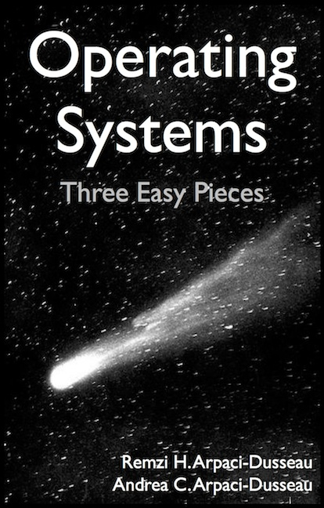
How I Prepared (and am still preparing)
read textbooks
Notes:
Now back to the course, since it’s very challenging;
You might wonder that, as the instructor, how I prepared for teaching this course.
First, I read related textbooks, for many times.

Slide 24
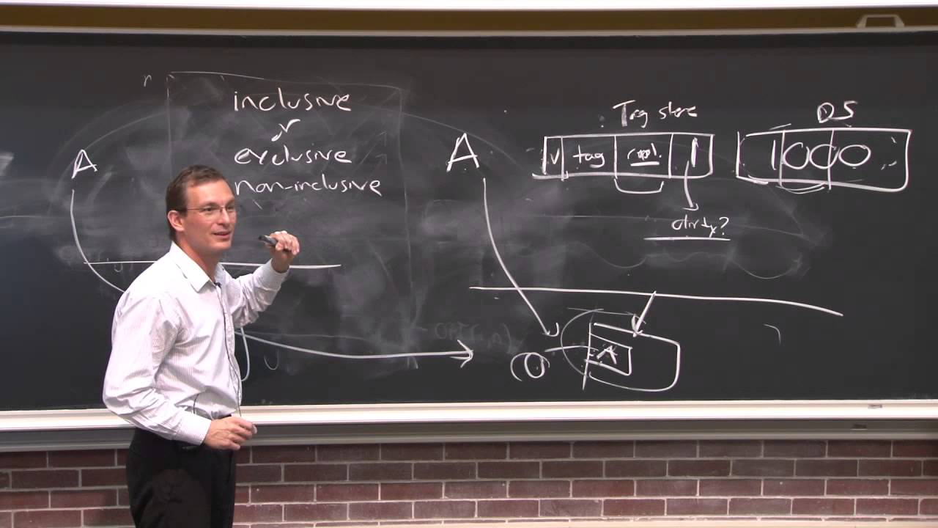
How I Prepared (and am still preparing)
watch video lectures
Notes:
Watch online video lectures

Slide 25

How I Prepared (and am still preparing)
practice English
Notes:
Practice English
Highly interested in Canadian English lately, hhh

Slide 26


and
even
read
this
book
Notes:
And, I also read a book that is literally called Teaching What You Don’t Know

Slide 27
What’s to deliver?
Notes:
So, after these much preparation, what can I offer to students in my class?

Slide 28
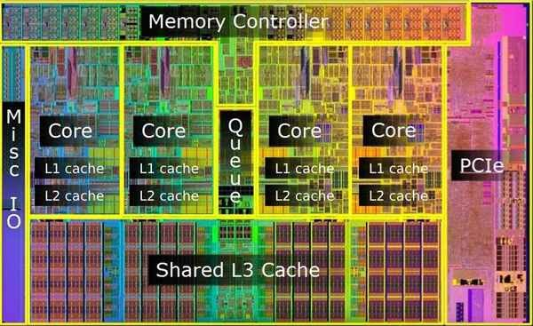
How a multi-core system works?
Notes:
After this course, you are expected to understand how a multi-core system works;
Intro: cpu chip in this fig, multiple cores, each core has local/private L1 and L2 caches, all cores share L3 cache, connect to memory via memory controller

Slide 29
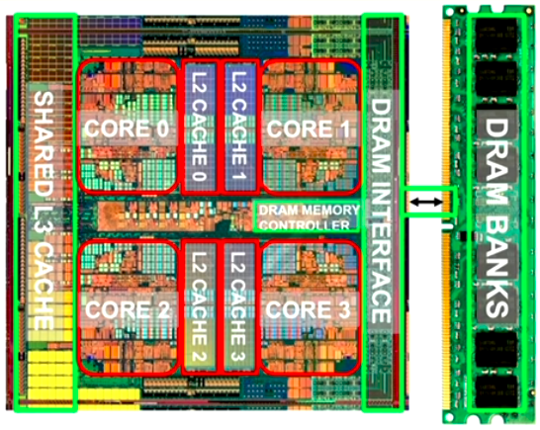
How a multi-core system works?
Notes:
Cpu and memory – computer architecture

Slide 30
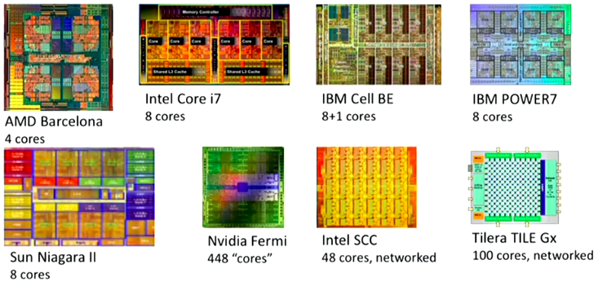
How a multi-core system works?
Notes:
More examples of multi-core CPUs

Slide 31
know not only how but also why and why not
Notes:
You’ll start paying attention to not only how something works but also why it works in that way.
You may also start wondering why it doesn’t work in some other ways.

Slide 32
understand the principles
Notes:
Through such comparison, you can better understand the working principles of things.

Slide 33
explore the tradeoffs of
different designs and ideas
Notes:
You’ll more and more get used to seeing things from different perspectives.
At most cases, a solution cannot be the best at every perspective.
You need to decide which perspective you care the most, and in order to get more benefits from this perspective, you might need to sacrifice some in terms of other perspectives.
Example, membership query using hash: space and accuracy;

Slide 34
thought-provoking!
Notes:
Probably it’ll be the most thought-provoking course you’ve even taken so far.

Slide 35
Textbook
Computer Architecture:
A Quantitative Approach
6th edition
John L. Hennessy
David A. Patterson
Notes:
The textbook we use is Computer Architecture: A quantitative approach 6th edition by Professor Hennessy and Professor Patterson.

Slide 36
Online Companion
6th Edition
https://www.elsevier.com/books-and-journals/book-companion/9780128119051
Notes:
A varriety of resources are available online including reference appendices and links to related materials on the Web, etc.
A variety of resources are available online at https://www.elsevier.com/books/ computer-architecture/hennessy/978-0-12-811905-1, including the following:
Reference appendices, some guest authored by subject experts, covering a range of advanced topics
Historical perspectives material that explores the development of the key ideas presented in each of the chapters in the text
Instructor slides in PowerPoint
Figures from the book in PDF, EPS, and PPT formats
Links to related material on the Web
List of errata

Slide 37
Why This Book?
Quantitative approach:
Performance driven
Know not only how but also why (not)
As in this book
Operating Systems: Three Easy Pieces
Notes:
So why this book?
It presents computer architecture design in a quantitative approach, which adopts a performance-driven perspective. In other words, whenever it delivers a design technique, it clearly motivates how this technique makes our computers faster or better in terms of other measurement methodology.
So it tells us not only how computer architecture works but also why it works in the way it is designed (instead of some other ways).
You are also strongly encouraged to read the book Operating Systems: Three Easy Pieces as well, as os is a prerequisite for computer architecture.

Slide 38

Course Website
http://list.zju.edu.cn/kaibu/comparch2022/
Notes:
all announcements and materials like slides and assignments will be posted on this website.

Slide 39
Syllabus
Reference syllabus by Prof. Jiang
https://list.zju.edu.cn/kaibu/comparch2021/syllabus-tentative.doc
Notes:
Here’re the link for reference syllabus

Slide 40
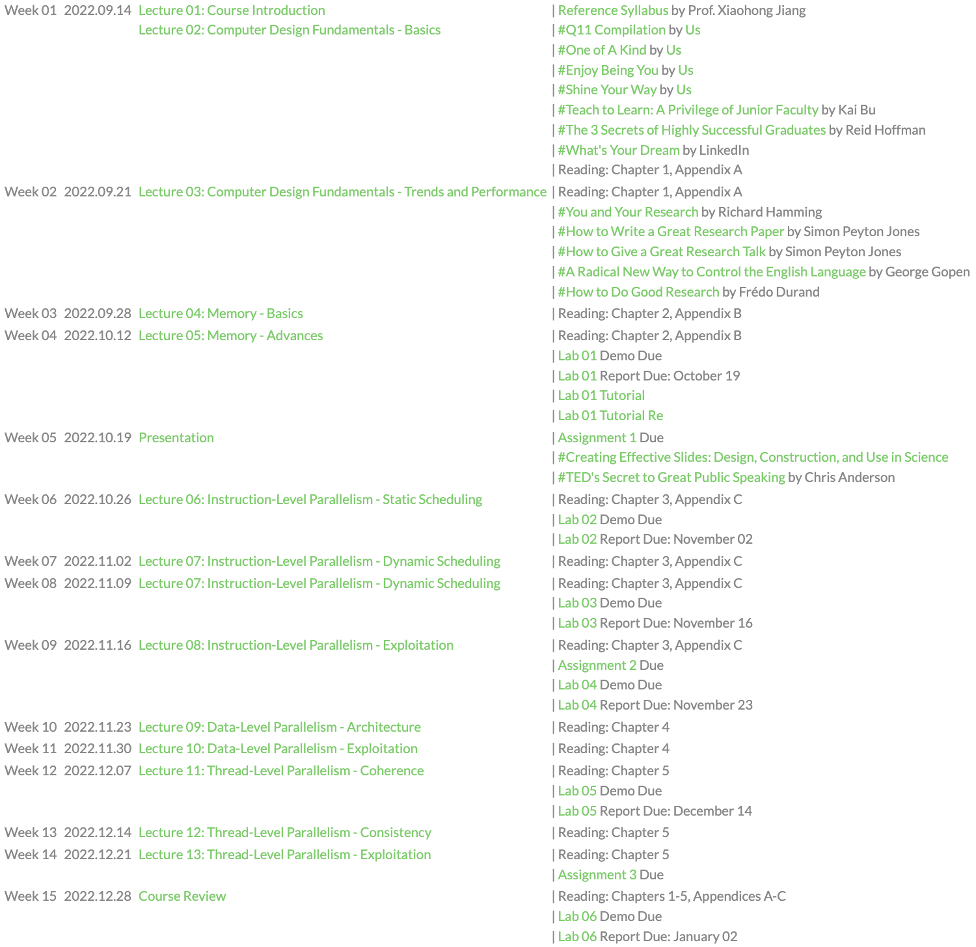
Schedule
Notes:
and schedule

Slide 41
Teaching Components
Lecture
Lab OR Research
Assignment & Quiz & Exam
Notes:
The course contains three major teaching components; they are lectures, labs OR research practice, and tests including assignments, quizzes, and exams;

Slide 42
Teaching Components
Lecture
Lab OR Research
Assignment & Quiz & Exam
Notes:
Let’s start from walking through the key topics to be covered in lectures.

Slide 43
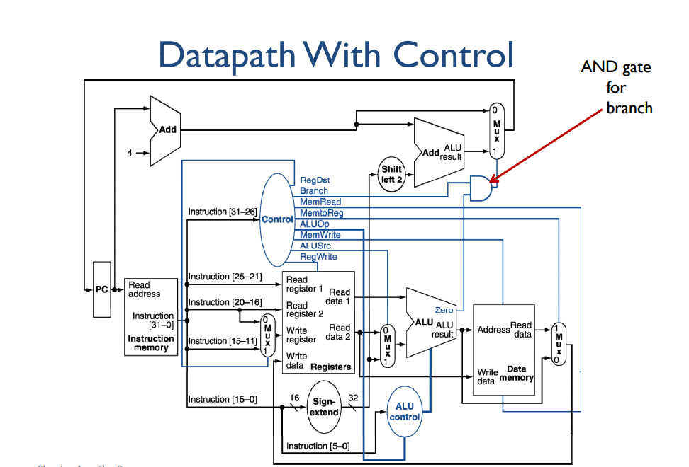
Left off in Organization
single cycle
instruction execution
Notes:
This is where you left off in Computer Organization, computer hardware processes an instruction in a single clock cycle.
By single clock cycle, it means that within each clock cycle, only one instruction is being processed.
Limitation? (long clock cycles, other instructions have to wait even though some components are idle)

Slide 44
Left off in Organization
s i n g l e c y c l e
instruction execution
Notes:
This is where you left off in Computer Organization, computer hardware processes an instruction in a single clock cycle.
By single clock cycle, it means that within each clock cycle, only one instruction is being processed.
Limitation? (long clock cycles, other instructions have to wait even though some components are idle)
A long single cycle
Long single clock
Set clock frequency
To fit the longest instruction
The overall extra waiting time
For shorter instructions

Slide 45
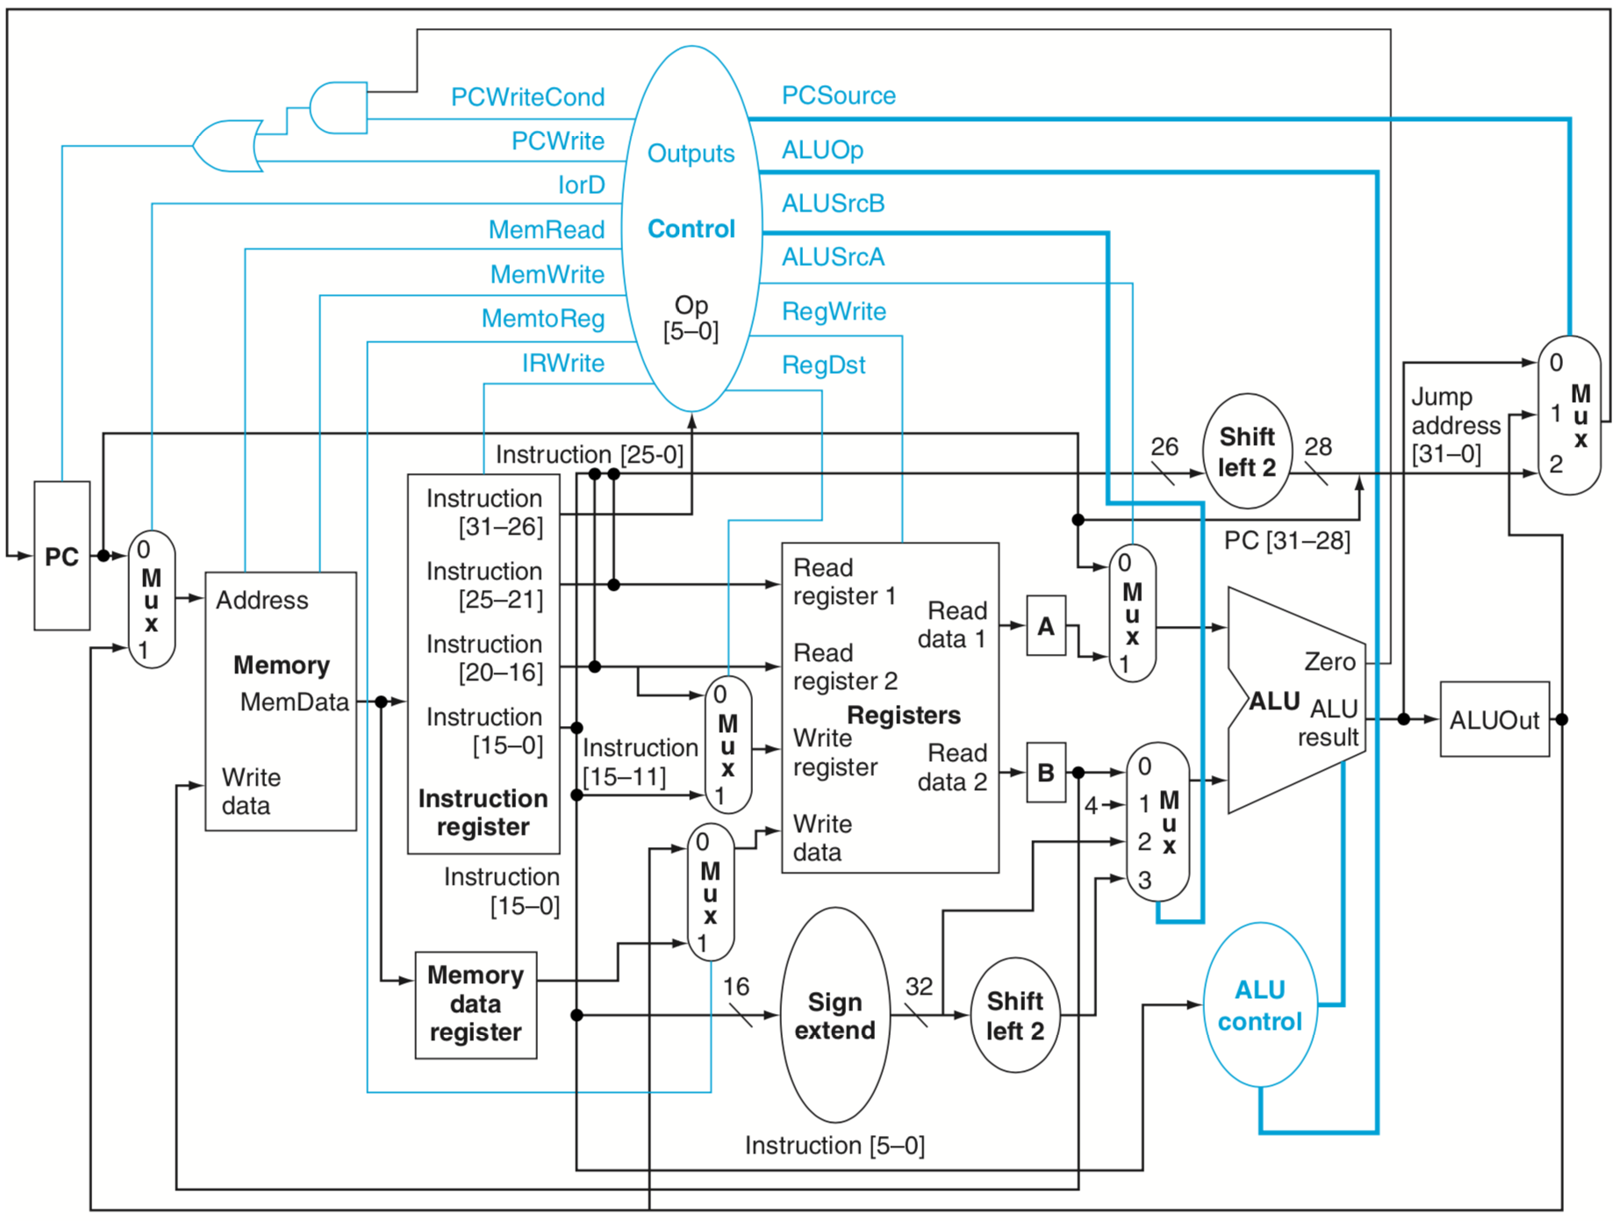
Left off in Organization
m u l t i p l e c y c l e s
instruction execution
Notes:
This is where you left off in Computer Organization, computer hardware processes an instruction in a single clock cycle.
By single clock cycle, it means that within each clock cycle, only one instruction is being processed.
Limitation? (long clock cycles, other instructions have to wait even though some components are idle)
Or a shorter cycle, yet taking multiple cycles for an instruction (instructions with varying cycles to complete)
Discussions:
Pros and cons of multi-cycle
State diagram, diff instruction goes through different number of states
So, averagely, save extra waiting time?
For multicycle datapath:
each instruction into a series of steps corresponding to the functional unit operations that were needed. We can use these steps to create a multicycle implementation. In a multicycle implementation, each step in the execution will take 1 clock cycle. The multicycle implementation allows a functional unit to be used more than once per instruction, as long as it is used on different clock cycles. This sharing can help reduce the amount of hardware required. The ability to allow instructions to take different numbers of clock cycles and the ability to share functional units within the execution of a single instruction are the major advantages of a multicycle design.

Slide 46
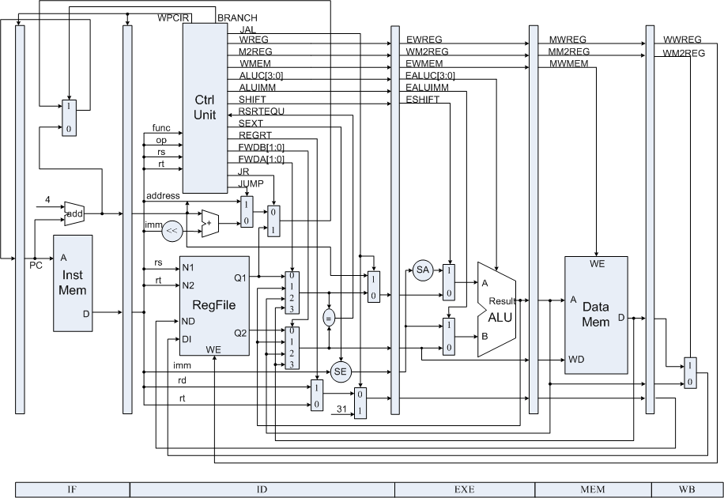
Now in Architecture
Pipelining
Divide instruction execution into stages

Slide 47
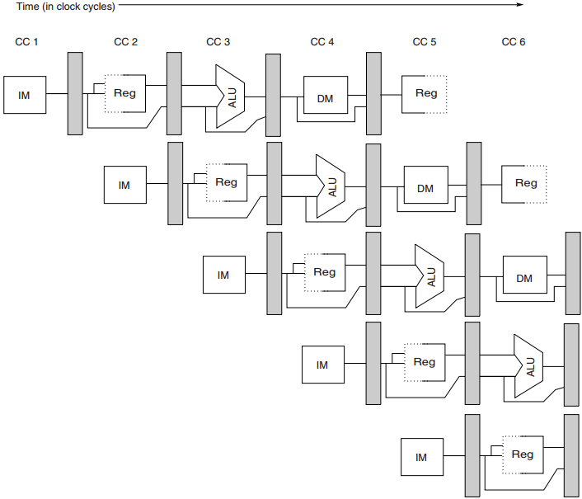
Pipelining
start executing one instruction
before completing the previous one

Slide 48
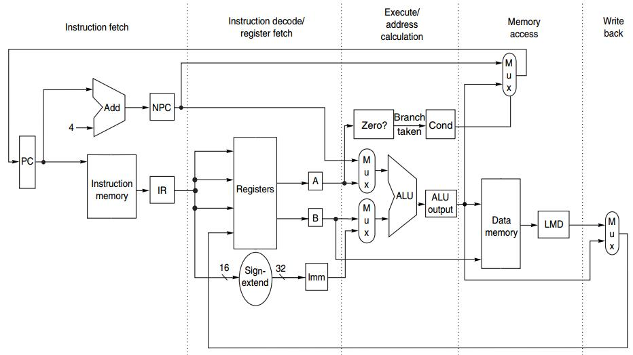
Pipelined Instruction
at most 5 clock cycles per instruction
IF ID EX MEM WB

Slide 49
Pipelined Instruction
IF ID EX MEM WB
IR ← Mem[PC];
NPC ← PC + 4;

Slide 50
Pipelined Instruction
IF ID EX MEM WB
A ← Regs[rs];
B ← Regs[rt];
Imm ← sign-extended
immediate field
of IR (lower 16 bits)

Slide 51
Pipelined Instruction
IF ID EX MEM WB
ALUOutput ← A + Imm;
ALUOutput ← A func B;
ALUOutput ← A op Imm;
ALUOutput ← NPC + (Imm<<2);
Cond ← (A == 0);

Slide 52
Pipelined Instruction
IF ID EX MEM WB
LMD ← Mem[ALUOutput]; Mem[ALUOutput] ← B;
if (cond) PC ← ALUOutput;

Slide 53
Pipelined Instruction
IF ID EX MEM WB
Regs[rd] ← ALUOutput;
Regs[rt] ← ALUOutput;
Regs[rt] ← LMD;

Slide 54
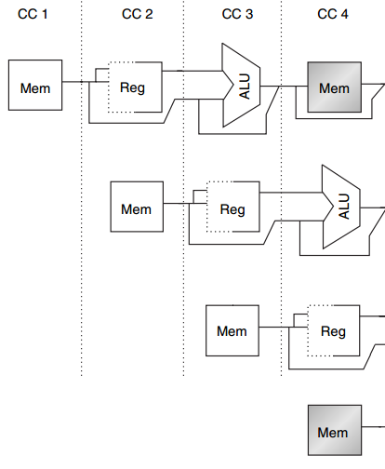
Structural Hazard
MEM
Example
1 mem port
mem conflict
data access
vs
instr fetch
load
instr i+1
instr i+2
IF
instr i+3
Notes:
Here’s an example of structural hazard due to memory conflict.
Assume the processor has only memory port.
A structural hazard will arise in clock cycle 4 when the load instruction reads data from memory and instruction i plus 3 fetches instruction from memory.

Slide 55
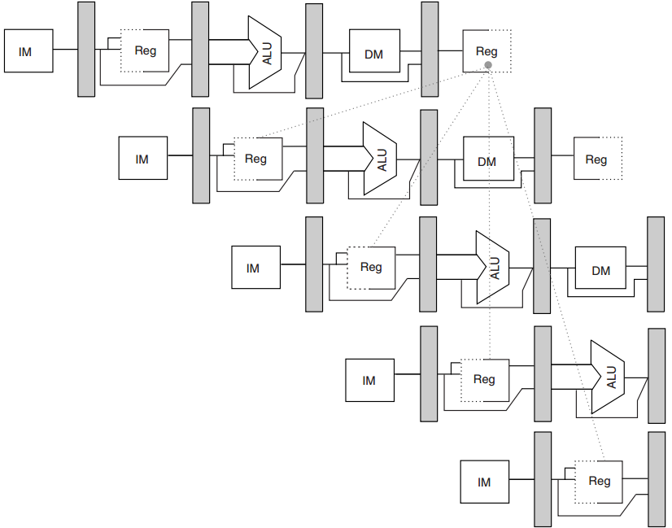
Data Hazard
R1
add
x1, x2, x3
sub
x4, x1, x5
and
x6, x1, x7
No hazard
1st half cycle: w
2nd half cycle: r
or
x8, x1, x9
xor
x10, x1, x11
Notes:
In this example, the subtract and AND instructions need R1 before the add instruction prepares it. So R1 causes a data hazard that prevents normal pipelining of the subtract and AND instructions.
Note that the OR instruction has no hazard because the add instruction prepares R1 in the first half of the clock cycle while the OR instruction needs R1 till the second half.

Slide 56
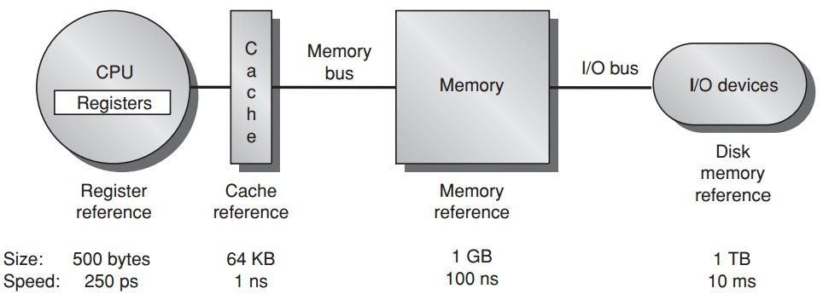
Memory Hierarchy

Slide 57
Cache Performance
Memory stall cycles
the number of cycles during processor is stalled waiting for a mem access
Miss rate
number of misses over number of accesses
Miss penalty
the cost per miss (number of extra clock cycles to wait)

Slide 58
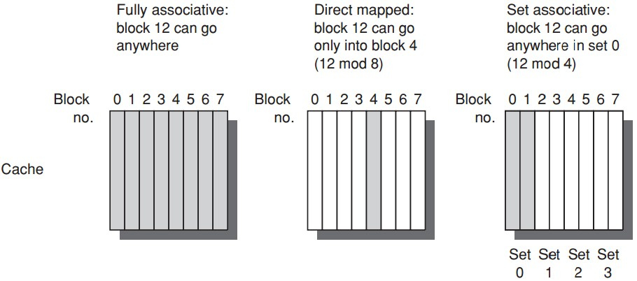
Block Placement

Slide 59
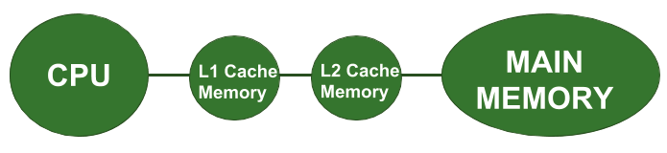
Multilevel Cache
Two-level cache
Add another level of cache between the original cache and memory
L1: small enough to match the clock cycle time of the fast processor;
L2: large enough to capture many accesses that would go to main memory, lessening miss penalty

Slide 60
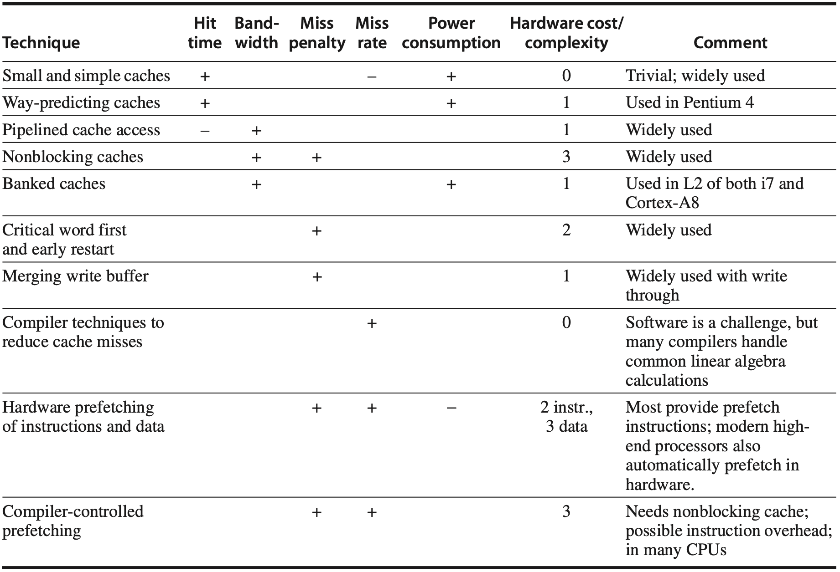
Cache Optimization
Notes:
Figure 2.18 Summary of 10 advanced cache optimizations showing impact on cache performance, power consumption, and complexity. Although generally a technique helps only one factor, prefetching can reduce misses if donesufficientlyearly;ifnot,itcanreducemisspenalty.+meansthatthetechniqueimprovesthefactor,% means it hurts that factor, and blank means it has no impact. The complexity measure is subjective, with 0 being the easiest and 3 being a challenge.

Slide 61
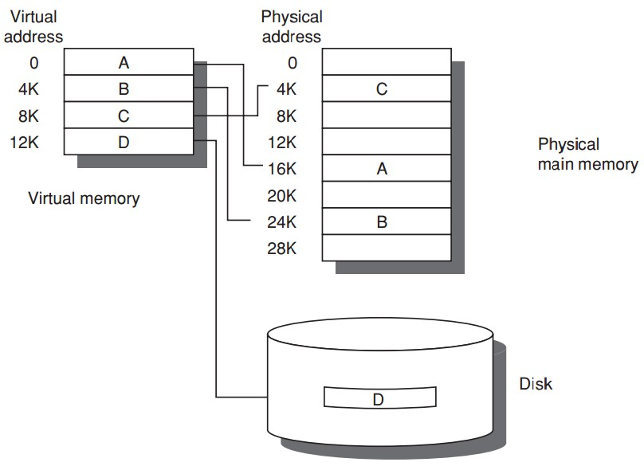
Virtual Memory
Program uses
discontiguous memory locations
Use secondary/non-memory storage

Slide 62
Virtual Memory
Program thinks
contiguous memory locations
larger physical memory

Slide 63
Prior to Virtual Memory
Main/Physical Memory
Contiguous allocation
Direct memory access
allocated
Process A
Process B
allocated
Notes:
If we directly map process address space to physical memory address, we need to follow contiguous allocation like this.
Then each process can use direct memory access using physical memory address.

Slide 64
Prior to Virtual Memory
Main/Physical Memory
efficiency?
used
Process A
Process B
used
Notes:
One possible limitation of such direct memory access is low memory efficiency.
As we can see, at certain time instants, a process uses way less memory than it is allocated for.

Slide 65
Prior to Virtual Memory
Main/Physical Memory
protection?
used
Process A
Process B
used
Notes:
Another limitation is lack of memory protection to prevent a process from accessing memory allocated for other processes.

Slide 66
Prior to Virtual Memory
Main/Physical Memory
Easier/flexible memory management
Virtual memory
used
used
Process A
Process B
used
used
Notes:
To address the above limitations, virtual memory introduces an indirect mapping from the virtual memory address processes use to the physical memory address where data actually locates.

Slide 67
Prior to Virtual Memory
Main/Physical Memory
Share a smaller amount of physical memory among many processes
Virtual memory
used
used
Process A
Process B
used
used
Notes:
Each process still thinks that the same amount of memory space is allocated for it;
But in practical, not all data need to be pre-loaded into memory and processed data could be evicted from memory.
This way, a smaller physical memory can support more processes.

Slide 68
Prior to Virtual Memory
Main/Physical Memory
Physical memory allocations
need not be contiguous
Virtual memory
used
used
used
Process A
used
Process B
used
used
used
used
Notes:
Besides, memory allocations no longer need to be contiguous,
Virtual address can point to any physical address.

Slide 69
Prior to Virtual Memory
Main/Physical Memory
memory protection;
process isolation
Virtual memory
used
used
used
Process A
used
Process B
used
used
used
used
Notes:
As now processes access memory through virtual address instead of physical address,
with well designed address mapping,
we can make sure that a process cannot access memory allocated for other processes.

Slide 70
Prior to Virtual Memory
Main/Physical Memory
Introduces another level of
secondary storage
Virtual memory
used
used
used
Process A
used
Process B
used
used
used
used
Notes:
To support larger virtual memory space, data blocks corresponding to virtual addresses can also be temporarily stored in secondary storage like disk and swapped to memory when needed.

Slide 71
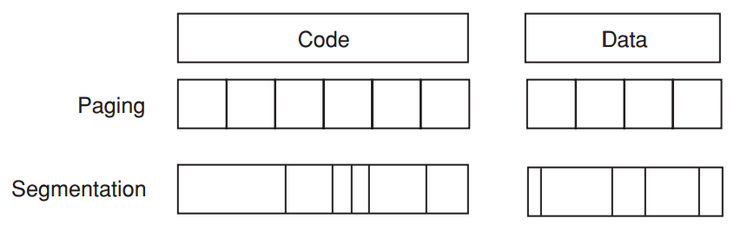
Virtual Memory
Paged virtual memory
page: fixed-size block
Segmented virtual memory
segment: variable-size block

Slide 72
Virtual Memory
Paged virtual memory
page address: page # + offset
Segmented virtual memory
segment address: seg # + offset

Slide 73
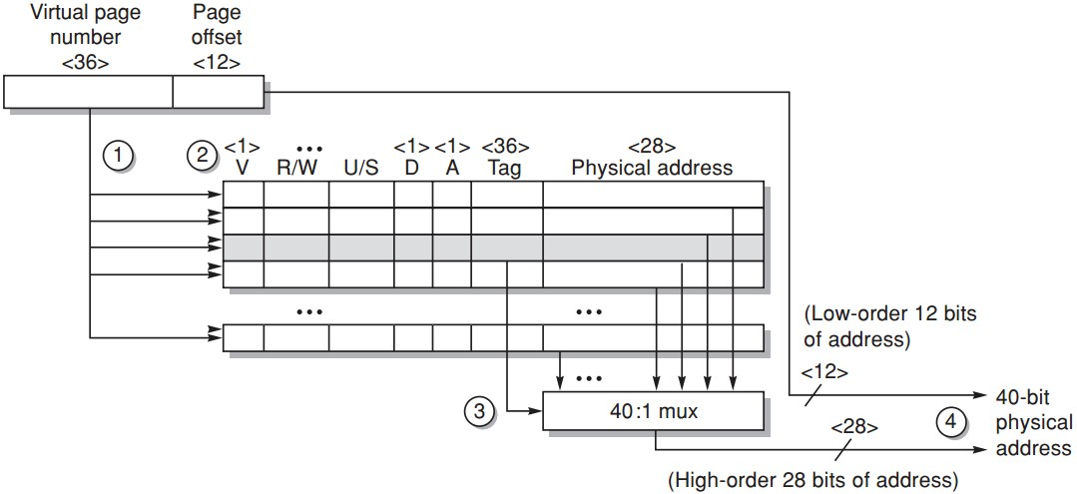
TLB Example
Opteron data TLB
Steps 1&2: send the virtual address to all tags
Step 2: check the type of mem access against protection info in TLB
https://www.youtube.com/watch?v=95QpHJX55bM
Notes:
Here’s an example of how TLB works for address translation.
First, the virtual page number is sent to compare with all tags;

Slide 74
TLB Example
Opteron data TLB
Steps 3: the matching tag sends phy addr through multiplexor
Notes:
The matching tag returns its physical page number through multiplexor;

Slide 75
TLB Example
Opteron data TLB
Steps 4: concatenate page offset to phy page frame to form final phy addr
Notes:
Then the physical page number is combined with page offset to form the physical address.

Slide 76
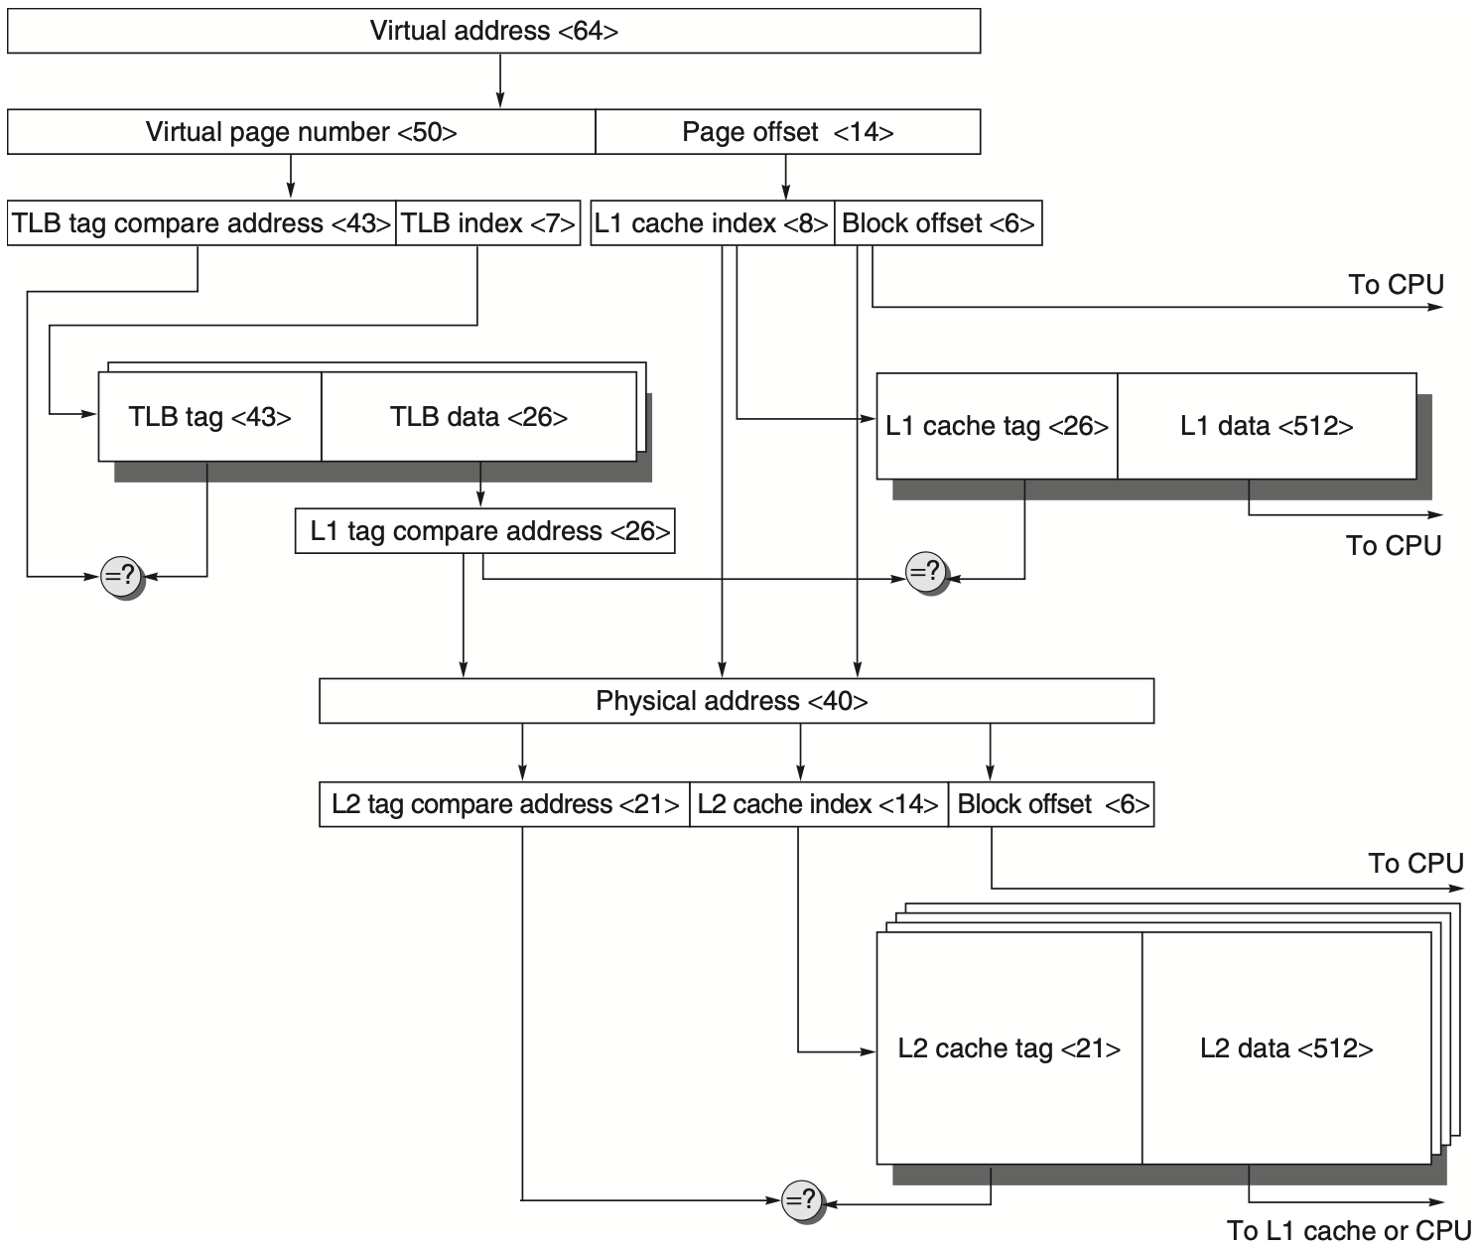
Virtual Memory + Caches
Notes:
To be covered in later lectures.
One alternative to get the best of both virtual and physical caches is to use part of the page offset—the part that is identical in both virtual and physical addresses—to index the cache. At the same time as the cache is being read using that index, the virtual part of the address is translated, and the tag match uses physical addresses.
This alternative allows the cache read to begin immediately, and yet the tag comparison is still with physical addresses. The limitation of this virtually indexed, physically tagged alternative is that a direct-mapped cache can be no bigger than the page size. For example, in the data cache in Figure B.5 on page B-13, the index is 9 bits and the cache block offset is 6 bits. To use this trick, the virtual page size would have to be at least 2(9+6) bytes or 32 KB. If not, a portion of the index must be translated from virtual to physical address. Figure B.17 shows the organization of the caches, translation lookaside buffers (TLBs), and virtual memory when this technique is used.

Slide 77
ILP Exploitation
Compiler-based static parallelism only in domain-specific environments or in well-structured scientific applications with significant data-level parallelism
Hardware-based dynamic parallelism
Notes:
There are two largely separable approaches to exploiting ILP: (1) an approach that relies on hardware to help discover and exploit the parallelism dynamically, and (2) an approach that relies on software technology to find parallelism statically at compile time. Processors using the dynamic, hardware-based approach, includ- ing all recent Intel and many ARM processors, dominate in the desktop and server markets. In the personal mobile device market, the same approaches are used in processors found in tablets and high-end cell phones. In the IOT space, where power and cost constraints dominate performance goals, designers exploit lower levels of instruction-level parallelism. Aggressive compiler-based approaches have been attempted numerous times beginning in the 1980s and most recently in the Intel Itanium series, introduced in 1999. Despite enormous efforts, such approaches have been successful only in domain-specific environments or in well-structured scientific applications with significant data-level parallelism.

Slide 78
Static Scheduling
Pipeline Scheduling
re-order instructions to avoid stalls
Loop Unrolling
replicate the loop body multiple times to increase the number of instructions relative to the branch and overhead instructions

Slide 79
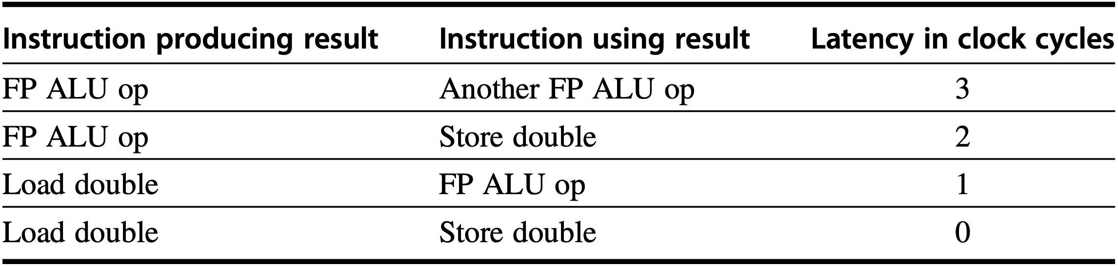
Pipeline Scheculing
RISC-V code
Loop:
How many clock cycles per loop?: 8
f0, 0(x1)
f4, f0, f2
f4, 0(x1)
x1, x1, -8
x1, x2, Loop
fld
fadd.d
fsd
addi
bne
1-CC stall
2-CC stall

Slide 80
Pipeline Scheculing
RISC-V code
Loop:
How many clock cycles per loop?: 7
f0, 0(x1)
x1, x1, -8
f4, f0, f2
f4, 8(x1)
x1, x2, Loop
fld
addi
fadd.d
fsd
bne
2-CC stall

Slide 81
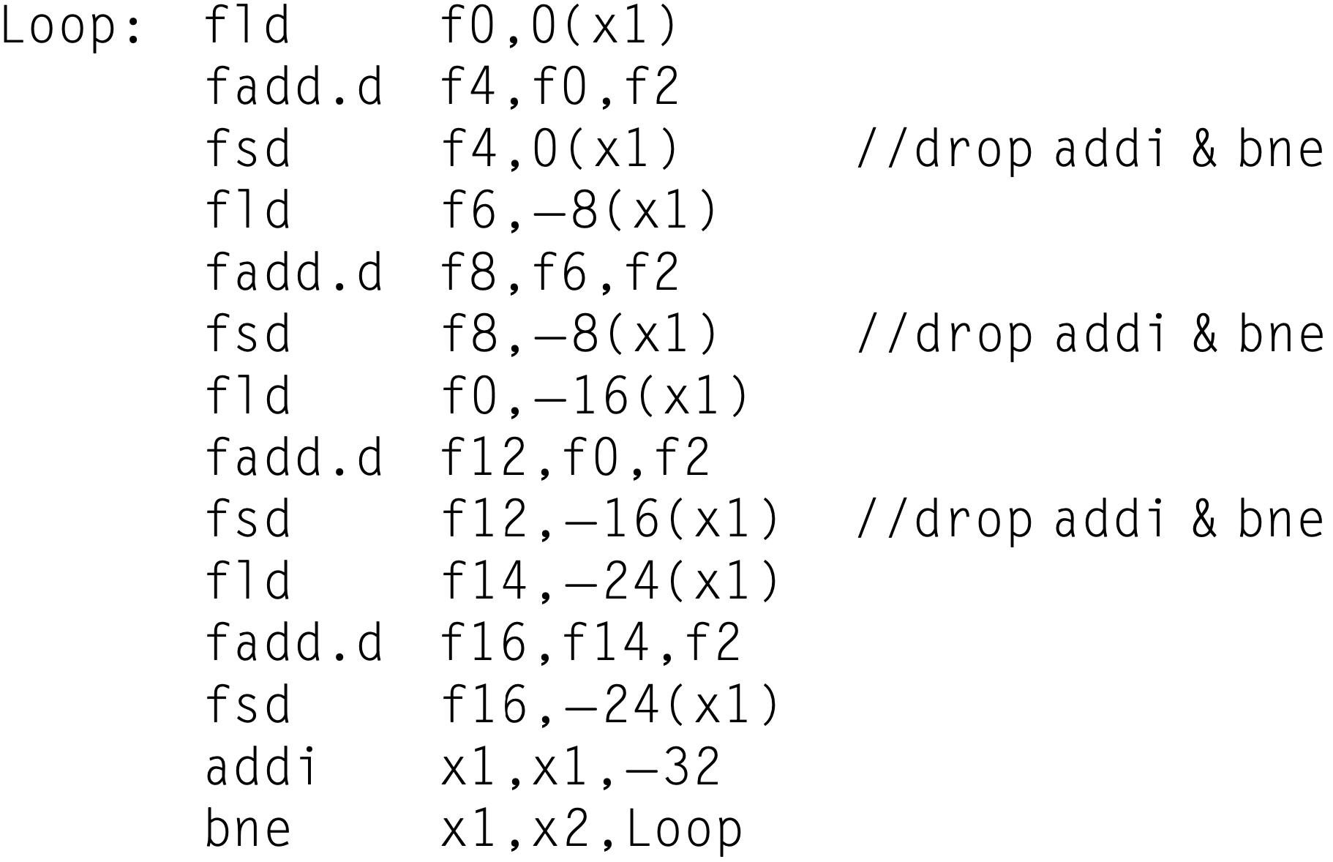
Loop Unrolling
RISC-V code
Notes:
how our loop unrolled so that there are four copies of the loop body, assuming x1 " x2 (that is, the size of the array) is initially a multiple of 32, which means that the number of loop iterations is a multiple of 4. Eliminate any obviously redundant computations and do not reuse any of the registers.
Here is the result after merging the addi instructions and dropping the unnec- essary bne operations that are duplicated during unrolling. Note that x2 must now be set so that Regs[x2]+32 is the starting address of the last four elements.
We have eliminated three branches and three decrements of x1. The addresses on the loads and stores have been compensated to allow the addi instructions on x1 to be merged.

Slide 82
Dynamic Scheduling
Enable out-of-order execution (and thus out-of-order completion)
Split ID into two stages: Issue: decode instructions, check for structural hazards Read operands: wait until no data hazards, then read operands
IF Issue Read-Operands EX MEM WB

Slide 83
Dynamic Scheduling
Issue from IF: in order
Read operands to EX: out of order when there are sufficient resources and no data dependences
Scheduling policy: upon stalling instr, issue other instructions if they do not depend on any active or stalled instruction

Slide 84
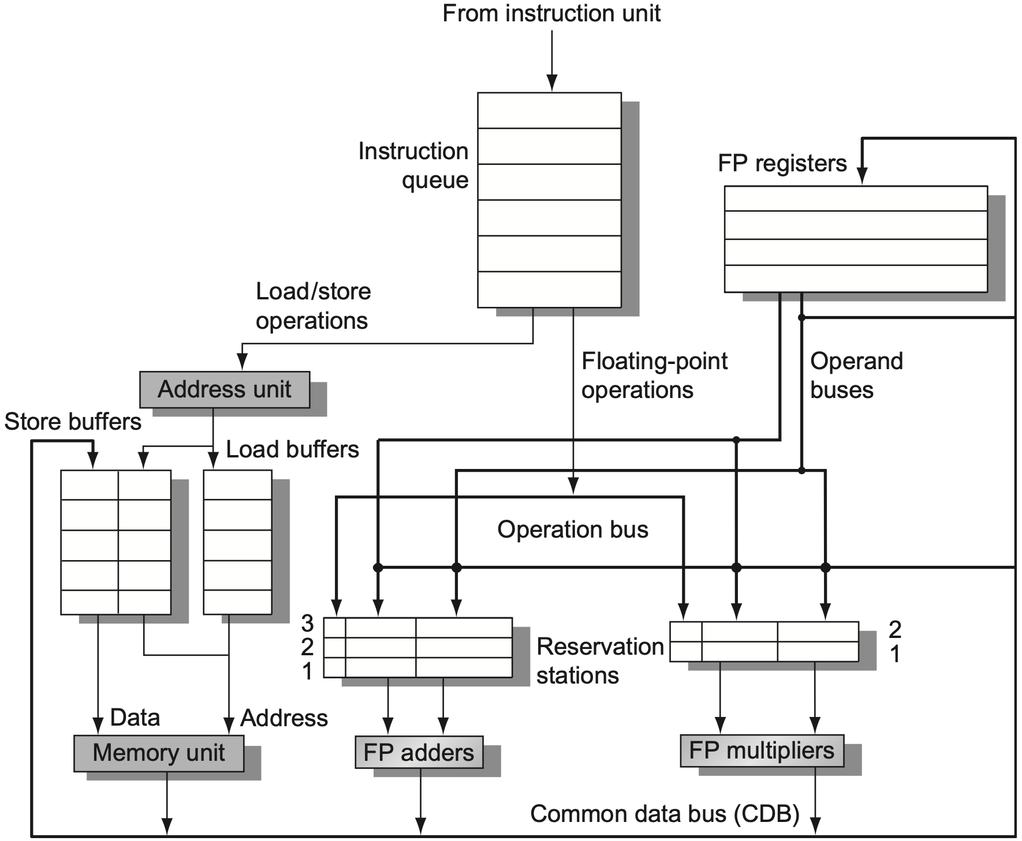
Tomasulo’s Algorithm
Notes:
Figure 3.10 The basic structure of a RISC-V floating-point unit using Tomasulo’s algorithm. Instructions are sent from the instruction unit into the instruction queue from which they are issued in first-in, first-out (FIFO) order. The reservation stations include the operation and the actual operands, as well as information used for detecting and resolving hazards. Load buffers have three functions: (1) hold the components of the effective address until it is com- puted, (2) track outstanding loads that are waiting on the memory, and (3) hold the results of completed loads that are waiting for the CDB. Similarly, store buffers have three functions: (1) hold the components of the effective address until it is computed, (2) hold the destination memory addresses of outstanding stores that are waiting for the data value to store, and (3) hold the address and value to store until the memory unit is available. All results from either the FP units or the load unit are put on the CDB, which goes to the FP register file as well as to the reservation stations and store buffers. The FP adders implement addition and subtraction, and the FP multipliers do multiplication and division.

Slide 85
how to exec before resolved?
remember branch prediction:
while resolving branch, fetch&issue instr
if correct prediction, continue execution
if misprediction, re-fetch instructions

Slide 86
how to exec before resolved?
if correct prediction, continue execution
Notes:
As we try to exploit more instruction-level parallelism, maintaining control depen- dences becomes an increasing burden. Branch prediction reduces the direct stalls attributable to branches, but for a processor executing multiple instructions per clock, just predicting branches accurately may not be sufficient to generate the desired amount of instruction-level parallelism. A wide-issue processor may need to execute a branch every clock cycle to maintain maximum performance. Thus exploiting more parallelism requires that we overcome the limitation of control dependence.

Slide 87
how to exec before resolved?
if correct prediction, continue execution

Slide 88
how to exec before resolved?
if correct prediction, continue execution
speculate on branch outcome
execute program as if guesses are correct
Notes:
Overcoming control dependence is done by speculating on the outcome of branches and executing the program as if our guesses are correct. This mech- anism represents a subtle, but important, extension over branch prediction with dynamic scheduling.

Slide 89
how to exec before resolved?
if correct prediction, continue execution
fetch, issue, and execute instructions as if
branch predictions are always correct;
commit results till prediction is determined;
undo effects by misprediction;
Notes:
In particular, with speculation, we fetch, issue, and exe- cute instructions, as if our branch predictions are always correct; dynamic scheduling only fetches and issues such instructions. Of course, we need mech- anisms to handle the situation where the speculation is incorrect. Appendix H discusses a variety of mechanisms for supporting speculation by the compiler. In this section, we explore hardware speculation, which extends the ideas of dynamic scheduling.

Slide 90
Hardware Speculation
out-of-order execution&in-order commit
Instruction Commit allow an instruction to update register file or memory until the instruction is no longer speculative
Reorder Buffer (ROB) similar to stations/buffers in Tomasulo, act as a source of operands for instr; results updated to registers/memory until instruction commits;
Reorder Buffer (ROB)
Notes:
The reorder buffer (ROB) provides additional registers in the same way as the reservation stations in Tomasulo’s algorithm extend the register set. The ROB holds the result of an instruction between the time the operation associated with the instruction completes and the time the instruction commits. The ROB therefore is a source of operands for instructions, just as the reservation stations provide operands in Tomasulo’s algorithm. The key difference is that in Tomasulo’s algo- rithm, once an instruction writes its result, all subsequently issued instructions will find the result in the register file. With speculation, the register file is not updated until the instruction commits (and we know definitively that the instruction should execute); thus, the ROB supplies operands in the interval between completion of instruction execution and instruction commit. The ROB is similar to the store buffer in Tomasulo’s algorithm, and we integrate the function of the store buffer into the ROB for simplicity.

Slide 91
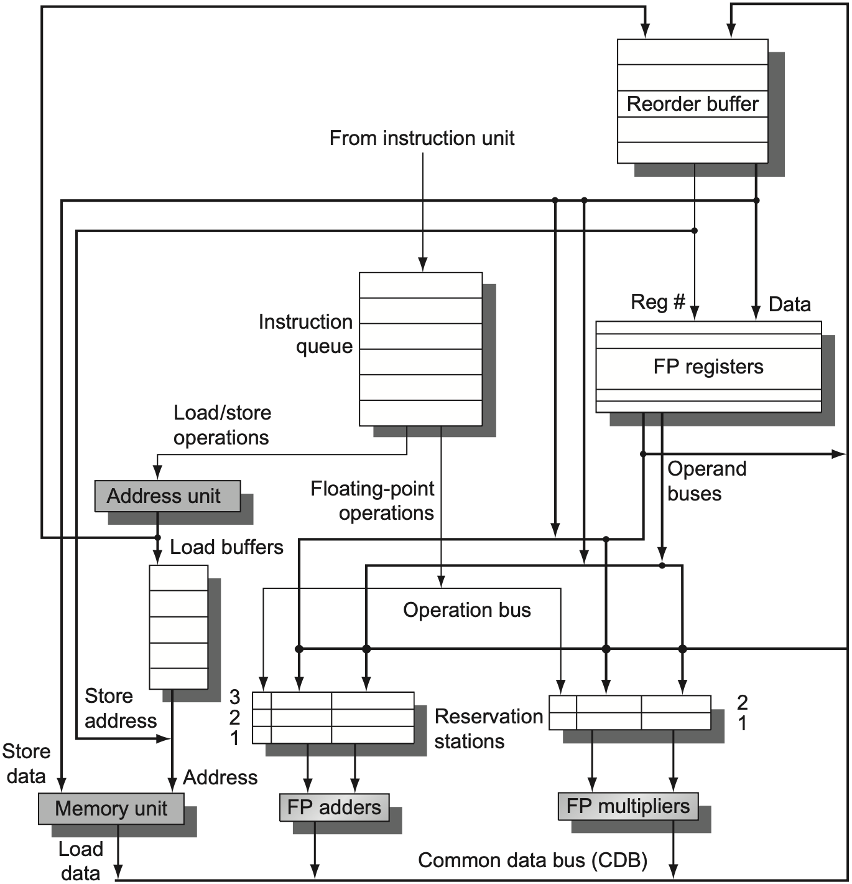
Hardware Speculation
Reorder Buffer (ROB)
Notes:
Figure 3.15 The basic structure of a FP unit using Tomasulo’s algorithm and extended to handle speculation. Comparing this to Figure 3.10 on page 198, which implemented Tomasulo’s algorithm, we can see that the major change is the addition of the ROB and the elimination of the store buffer, whose function is integrated into the ROB. This mechanism can be extended to allow multiple issues per clock by making the CDB wider to allow for mul- tiple completions per clock.

Slide 92
how i understood tomasulo

Slide 93
and speculation

Slide 94
Vector Architecture
Grab sets of data elements scattered about memory
Place them in large sequential reg files
Operate on data in those reg files
Disperse the results back into memory
A single instruction works on vector of data, which results in doezens of register-register operations on independent data elements

Slide 95
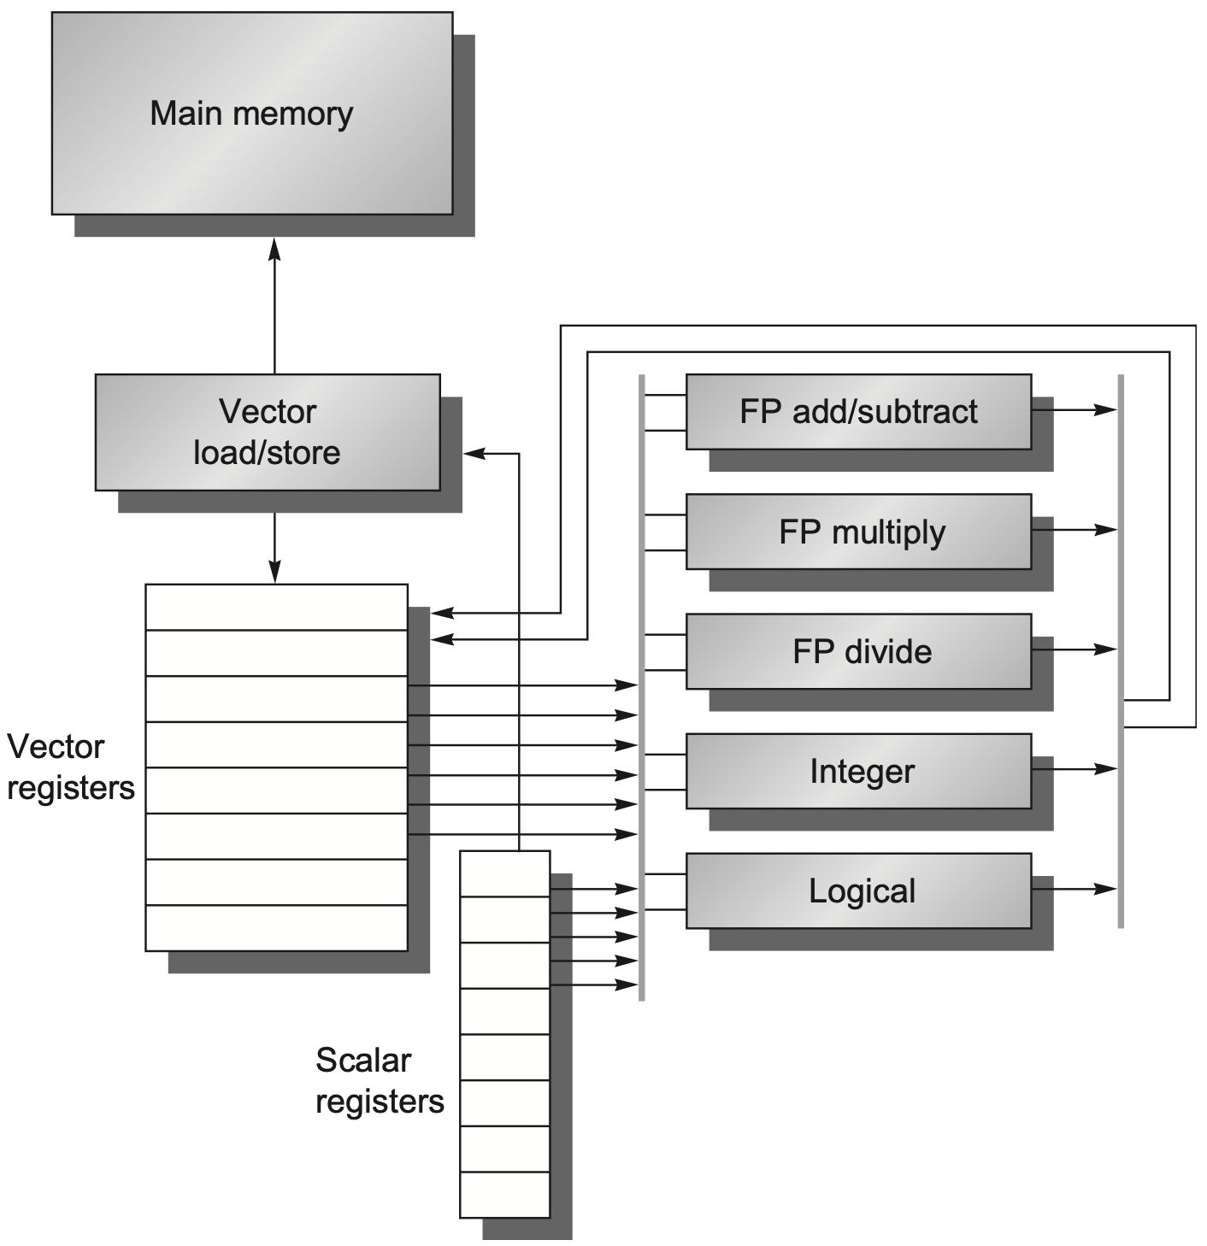
RV64V
Notes:
Figure 4.1 The basic structure of a vector architecture, RV64V, which includes a RISC-V scalar architecture. There are also 32 vector registers, and all the functional units are vector functional units. The vector and scalar registers have a significant number of read and write ports to allow multiple simultaneous vector operations. A set of crossbar switches (thick gray lines) connects these ports to the inputs and outputs of the vector functional units.
We begin with a vector processor consisting of the primary components that Figure 4.1 shows. It is loosely based on the 40-year-old Cray-1, which was one of the first supercomputers. At the time of the writing of this edition, the RISC- V vector instruction set extension RVV was still under development. (The vector extension by itself is called RVV, so RV64V refers to the RISC-V base instructions plus the vector extension.)

Slide 96
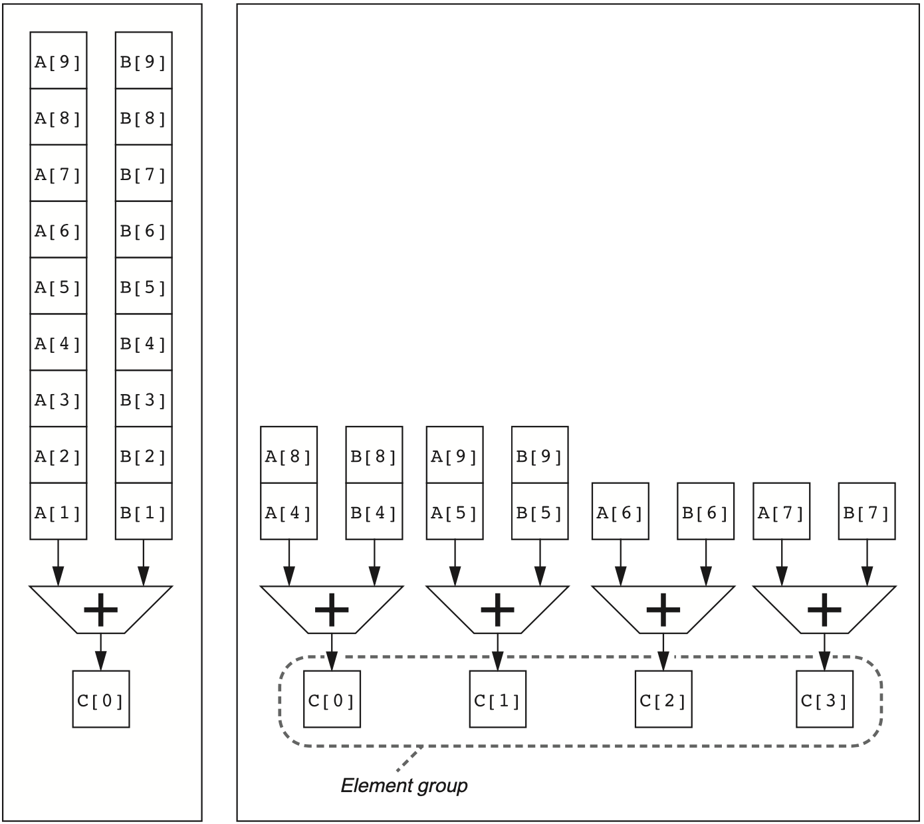
Multiple Lanes
use multiple functional units to improve vector performance;
process several elements per clock cycle;
Notes:
Figure 4.4 Using multiple functional units to improve the performance of a single vector add instruction, C5A+B. The vector processor (A) on the left has a single add pipeline and can complete one addition per clock cycle. The vector processor (B) on the right has four add pipelines and can complete four additions per clock cycle. The elements within a single vector add instruction are interleaved across the four pipelines. The set of elements that move through the pipelines together is termed an element group. Reproduced with permission from Asanovic, K., 1998. Vector Microprocessors (Ph.D. thesis). Computer Science Division, University of California, Berkeley.

Slide 97
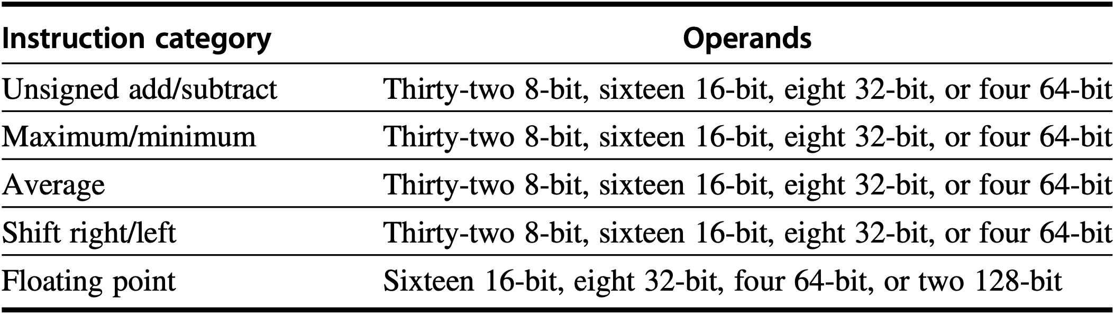
Multimedia SIMD
Suit for short, fixed-length vectors 256-bit-wide example operations:
Omissions: vector length register, strided or gather/scatter data transfer instructions, and mask registers

Slide 98
GPU
Support various types of parallelism: multithreading, MIMD, SIMD, ILP
Challenge for programming: not only getting good performance on GPU, but also in coordinating the scheduling of computation on the system processor and the GPU and the transfer of data between system memory and GPU memory

Slide 99
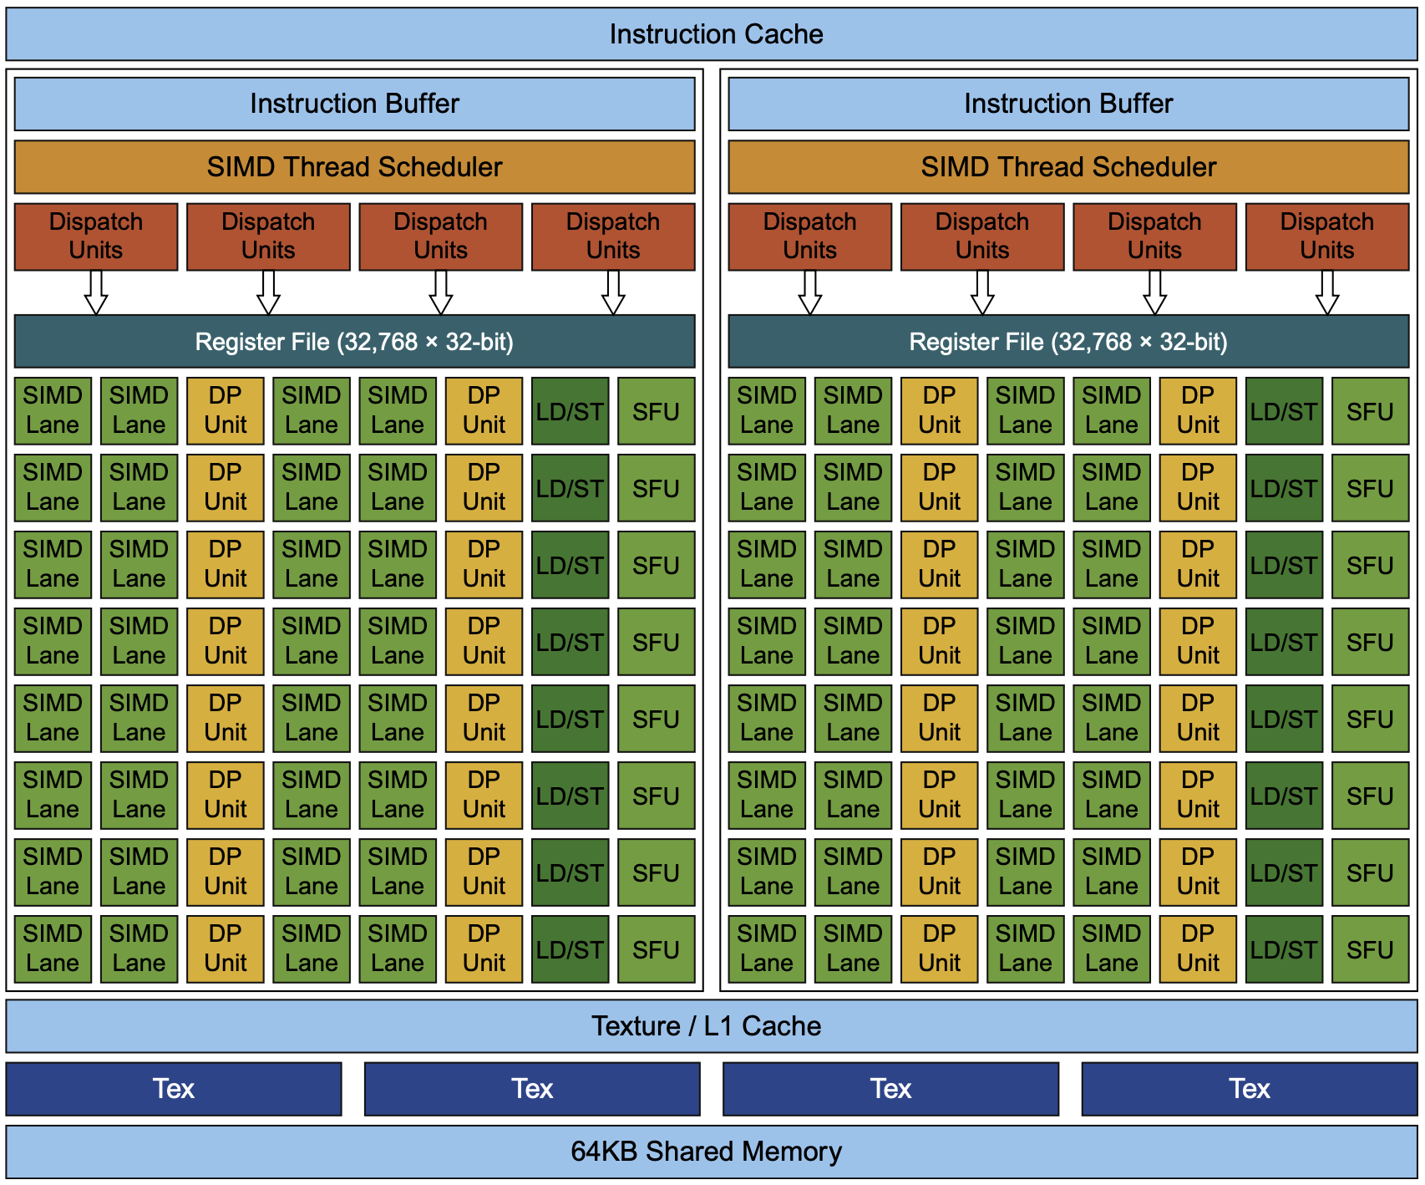
Pascal GPU
Notes:
Figure 4.20 Block diagram of the multithreaded SIMD Processor of a Pascal GPU. Each of the 64 SIMD Lanes (cores) has a pipelined floating-point unit, a pipelined integer unit, some logic for dispatching instructions and oper- ands to these units, and a queue for holding results. The 64 SIMD Lanes interact with 32 double-precision ALUs (DP units) that perform 64-bit floating-point arithmetic, 16 load-store units (LD/STs), and 16 special function units (SFUs) that calculate functions such as square roots, reciprocals, sines, and cosines.
https://versus.com/en/glossary/texture-rate
What is texture rate?
To understand the texture rate of a GPU, it helps first to know how it relates to the graphics card of a device and how they’re both tied to the GPU clock speed. Also known as engine clock, GPU clock speed indicates how fast the cores of a graphics processing unit (GPU) are. The function of these cores is to render graphics; therefore, the higher the GPU clock speed, the faster the processing.
Now, texture rate, also called texture fill rate, refers to the number of textured pixels that a graphics card can render on the screen every second. This means that it refers to the speed at which a graphics card can essentially “fill” the screen with pixels.
To calculate the texture fill rate, you need to know the GPU clock speed and the amount of TMUs, or texture mapping units, that a graphics card has. Generally, you’ll follow the following formula. You always express the texture fill rate as a measurement over time. The measurement is texels, which represent textured picture elements that are processed and shown on the screen.
Core Clock Speed x TMUs = Texture Fill Rate
However, depending on the hardware itself, the actual numbers can vary. In the case of the PNY Quadro RTX 8000, the core clock speed is 1395MHz, and the card has 288 TMUs. But you’ll see that the texture rate is 509.8 GTexels/s.

Slide 100
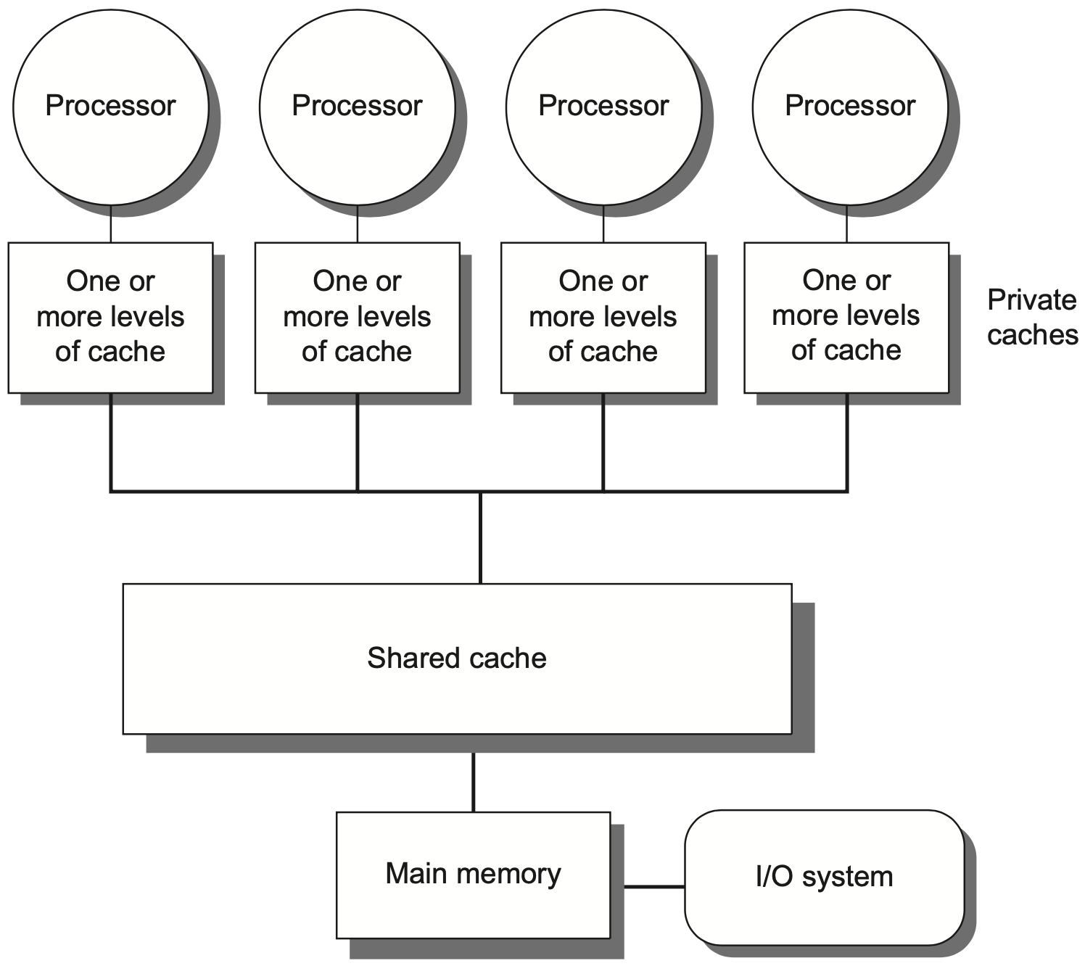
Centralized Shared-Memory
32 or fewer cores
Notes:
Centralized shared-memory multiprocessors usually feature eight or fewer cores.
Each processor has its own cache.
Figure 5.1 Basic structure of a centralized shared-memory multiprocessor based on a multicore chip. Multiple processor-cache subsystems share the same physical mem- ory, typically with one level of shared cache on the multicore, and one or more levels of private per-core cache. The key architectural property is the uniform access time to all of the memory from all of the processors. In a multichip design, an interconnection net- work links the processors and the memory, which may be one or more banks. In a single- chip multicore, the interconnection network is simply the memory bus.

Slide 101
Centralized Shared-Memory
Share a single centralized memory;
All processors have equal access
Notes:
All processors share a single centralized memory, to which all processors have equal access

Slide 102
Centralized Shared-Memory
All processors have uniform latency from memory
uniform memory access (UMA) multiprocessors
Notes:
All processors have uniform latency from memory
So centralized shared-memory multiprocessors are also called uniform memory access multiprocessors.

Slide 103
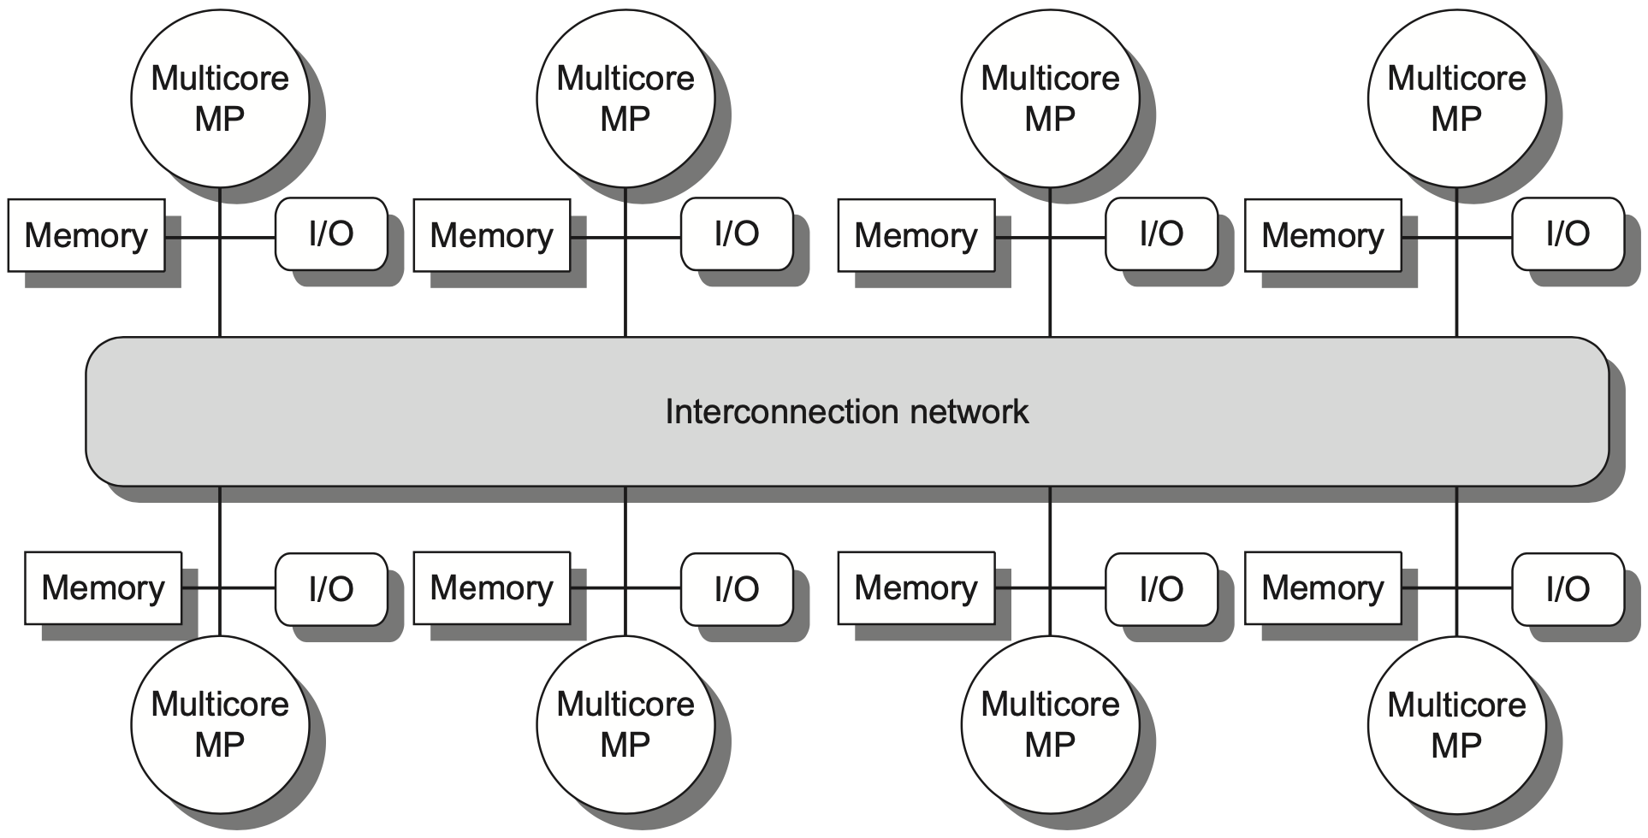
Distributed Shared-Memory
more processors
physically distributed memory
Notes:
In contrast, distributed shared memory multiprocessors support more processors and each is attached with a physically distributed memory.
Figure 5.2 The basic architecture of a distributed-memory multiprocessor in 2017 typically consists of a multi- core multiprocessor chip with memory and possibly I/O attached and an interface to an interconnection network that connects all the nodes. Each processor core shares the entire memory, although the access time to the local memory attached to the core’s chip will be much faster than the access time to remote memories.

Slide 104
Distributed Shared-Memory
more processors
physically distributed memory
Distributing memory among the nodes
increases bandwidth & reduces local-mem latency
Notes:
Distributing memory among multiple cores increases bandwidth (as more memory accesses can be executed at the same time) and reduces local-memory latency.

Slide 105
Distributed Shared-Memory
more processors
physically distributed memory
NUMA: nonuniform memory access
access time depends on data word loc in mem
Notes:
Clearly, access time varies with data location; fetching data from local memory should be faster than fetching data from distant memory.
So distributed shared-memory multiprocessors are also called Nnnuniform memory access multiprocessors

Slide 106
Distributed Shared-Memory
more processors
physically distributed memory
Disadvantages:
more complex inter-processor communication
more complex software to handle distributed mem
Notes:
But in comparison with centralized shared memory multiprocessors, distributed version requires more complex designs to handle inter-processor communication and distributed memory.

Slide 107
Cache Coherence Problem
A memory system is Coherent if any read of a data item returns the most recently written value of that data item
Two critical aspects
coherence: defines what values can be returned by a read
consistency: determines when a written value will be returned by a read
Notes:
Consistency is about ordering of all memory operations from different processors (i.e., to different memory locations).
Global ordering of accesses to all memory locations.
Coherence is about ordering of operations from different processors to the same memory location.
Local ordering of accesses to each cache block.
Cache coherence, memory consistency
https://www.quora.com/What-is-the-difference-between-cache-consistency-and-cache-coherence
Quote from Aamir Ogna, CPU Verification Engineer
“ As far as I know, there's no such thing is "cache" consistency. What you are referring to is probably memory consistency.
Cache coherency is relevant in a multicore system where each processor has a private L1 cache and at least one other level is shared. Memory consistency is relevant whether there are caches or not.
I like the way my professor taught it so I'll give the same example:
Let's say you are the main memory and you have two friends A and B who are two cores in a multicore environment:
A wants to go for a movie on Saturday. So he texts you asking for a good time. You reply back saying 9 PM is a good time. A gets the text, reads it and he is happy. He is also expecting you to co-ordinate the times with B.
A few minutes later, B texts you asking for the time of the movie. You send him the same reply you sent to A, 9 PM. At this point in time, all three of you are agreeing on the same time, that is to say, all of you have the same copy of data.
Something comes up in B's calendar and he needs to reschedule it. So he texts you saying instead of 9, you all will go for the movie at 10 PM. You get the text and your timing is updated. But you fail to pass on this message to A, who still thinks 9 PM is on.
At this point, you (main memory) and B (one of the cores) have the same data, but A (another core) has stale data, since the "write" to the data by B was never propagated to A. A will still show up at 9 PM for the movie, won't find either of you, get pissed off and watch the movie all alone, live texting you the entire story spoiling everything for you!
This is what cache coherency is all about. It's about making sure that every private copy is the same everywhere and if any changes are made, those changes are propagated to every private cache.
We can use the same example to understand memory consistency as well, but in this case, you are also a core:
A wants to go for the movie on Saturday at 9 PM. So he sends out a text_1 saying "Movie at 9" to both, you and B. A few minutes later, his plan changes and now he wants to watch it at 10 PM instead. So he sends out another text_2 saying "Movie at 10". So both, you and B are informed of the time changes, but something funky happens.
B's telephone network is crappy and he receives the text_2 BEFORE text_1. B is thinking the initial plan was 10 PM that got moved to 9 while you are thinking it was 9 PM that got moved to 10. In this case, both of you got updated copies, but at different times in a different order. Either ways, someone is going to get pissed and spoil the movie for the others.
This is memory consistency. It's not enough that a core sees the write happening to shared data, it's also important that they see the writes in the same order as other cores. Otherwise, data will be inconsistent across cores.
Hope this helps.
”

Slide 108
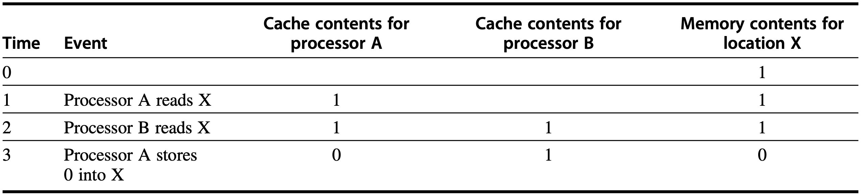
Cache Coherence Problem
without precautions
write-through cache
Notes:
The problem concerning whether the value of shared data is identical in different caches is called cache coherence problem.
Figure5.3 The cache coherence problem for a single memory location(X), read and written by two processors (A and B). We initially assume that neither cache contains the variable and that X has the value 1. We also assume a write- through cache; a write-back cache adds some additional but similar complications. After the value of X has been written by A, A’s cache and the memory both contain the new value, but B’s cache does not, and if B reads the value of X it will receive 1!

Slide 109
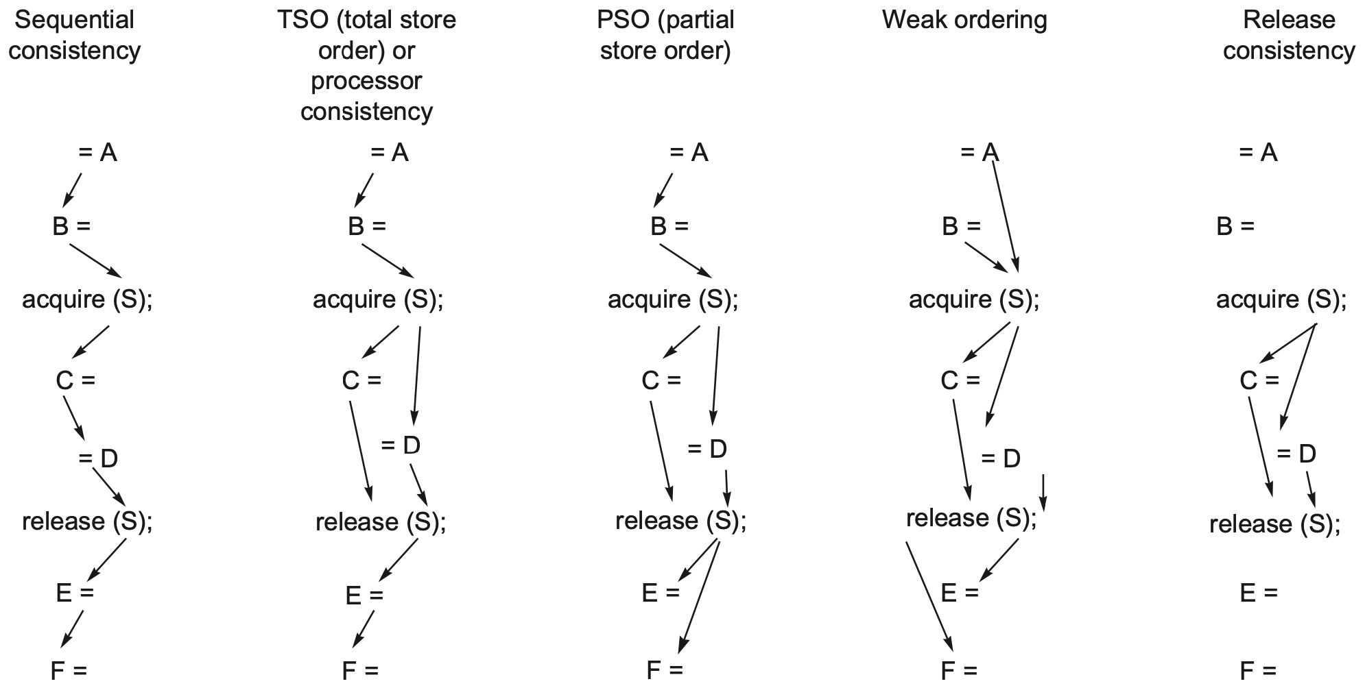
Orderings vs Consistency
= read
write =
Notes:
Figure 5.24 These examples of the five consistency models discussed in this section show the reduction in the number of orders imposed as the models become more relaxed. Only the minimum orders are shown with arrows. Orders implied by transitivity, such as the write of C before the release of S in the sequential consistency model or the acquire before the release in weak ordering or release consistency, are not shown.

Slide 110
Textbook Navigation
Fundamentals: Chapter 1
Memory: Chapter 2
Instruction-Level Parallelism: Chapter 3
Data-Level Parallelism: Chapter 4
Thread-Level Parallelism: Chapter 5

Slide 111
(Micro)Architecture
Architecture
the parts of a processor that one needs to understand to write assembly code;
directly visible to software;
Microarchitecture
implementation of the architecture
(oops…lack of details)

Slide 112
Teaching Components
Lecture
Lab OR Research
Assignment & Quiz & Exam
Notes:
Together with lecture sessions, we also have tight lab schedules to practice what we learn.

Slide 113
Lab
6 lab sessions
Pipeline implementation
Cache implementation
Demo: individual OR group of up to two
Report: individual
Notes:
In particular, through 6 lab assignments, we aim to implement pipeline and cache.

Slide 114
Lab
Teaching Assistant Chenlu Miao clmiao@zju.edu.cn
Tutorials from TA or YOU (tutorial.pptx/docx – for lab guidelines)
Demo: individual OR group of up to two
Report: individual
Notes:
In particular, through 6 lab assignments, we aim to implement pipeline and cache.

Slide 115
Lab
Lab 01: 6% Implement a 5-staged pipelined CPU with forwarding and predicted-not-taken to support RV32I instructions
Lab 02: 4% Implement handling of interrupt and exception on the pipelined CPU from Lab 01

Slide 116
Lab
Lab 03: 3% Implement a two-way associative cache through simulation
Lab 04: 4% Incorporate the two-way associative cache from Lab 03 to the pipelined CPU from Lab 02

Slide 117
Lab
Lab 05: 7% Extend the pipelined CPU from Lab 02 to support multi-cycle operations, out-of-order execution, and hazard detection
Lab 06: 8% Extend the pipelined CPU from Lab 05 to support dynamic scheduling such as Scoreboarding or Tomasulo

Slide 118
Lab
Call for lab assistants
help tutor & check the demo during lab sessions;
get bonus credit;
Notes:
For students who are familiar with lab experiments, you are strongly encouraged to join me as lab assistants.
As a lab assistant, you are expected to help tutor students and check demos.
Then, of course, you can get bonus credit as reward.

Slide 119
Teaching Components
Lecture
Lab OR Research
Assignment & Quiz & Exam
Notes:
Together with lecture sessions, we also have tight lab schedules to practice what we learn.

Slide 120
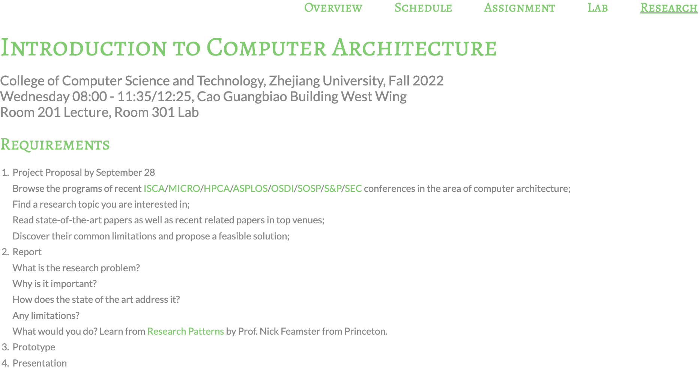
Research Practice
http://list.zju.edu.cn/kaibu/comparch2022/
research.html
WOW THE CLASS!

Slide 121
Why do you care?
Notes:
So why do u care about the research part?

Slide 122
waive lab demos&reports
Notes:
So why do u care about the research part?

Slide 123
spice up
graduate application

Slide 124
Special Thanks
Weixin Liang (Stanford PhD)
Ke Li (Columbia MS, Activision)
Jinhong Li (CUHK PhD)
Min Huang (CMU MS, LinkedIn)
Qinhan Tan (Princeton PhD)
Zhihua Zeng (Shopee, Microsoft)
Chenlu Miao (ZJU MS)
Yilong Yang (University of Virginia PhD)

Slide 125
Special Thanks
Yiming Wei, Jingsen Zhu, Xingjian Zhang, Miao Zhang, Yuan Tian, Tianqi Song, Danli Wen, Shuai Zeng, Yunjie Chu, Yaohui Zhang…

Slide 126
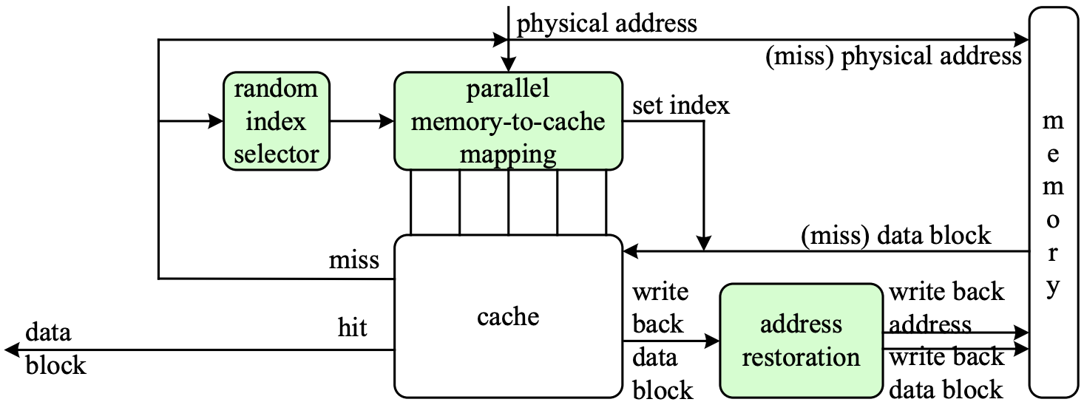
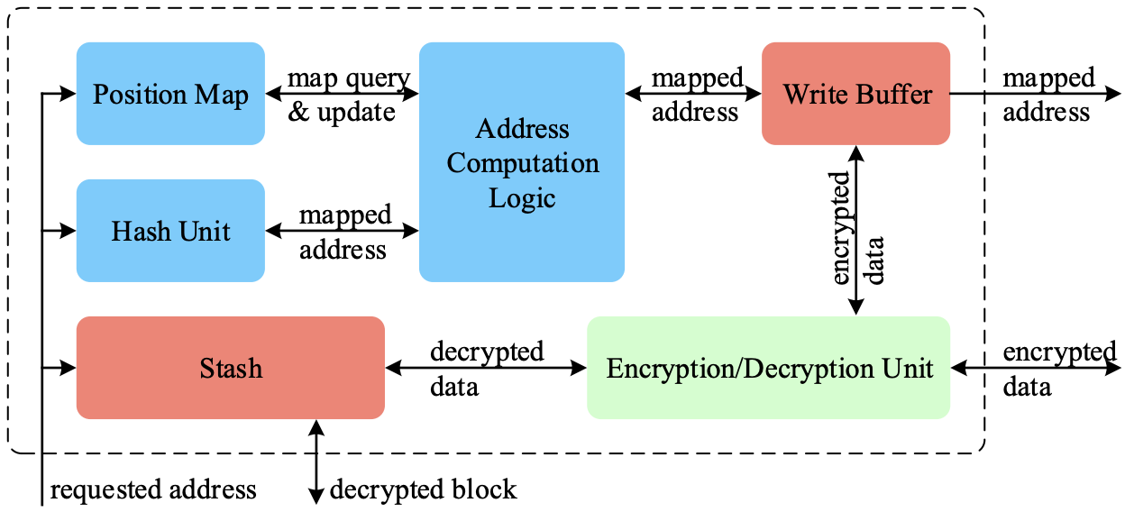
WOW
PhantomCache
NDSS 2020
MemCloak
ACSAC 2018

Slide 127
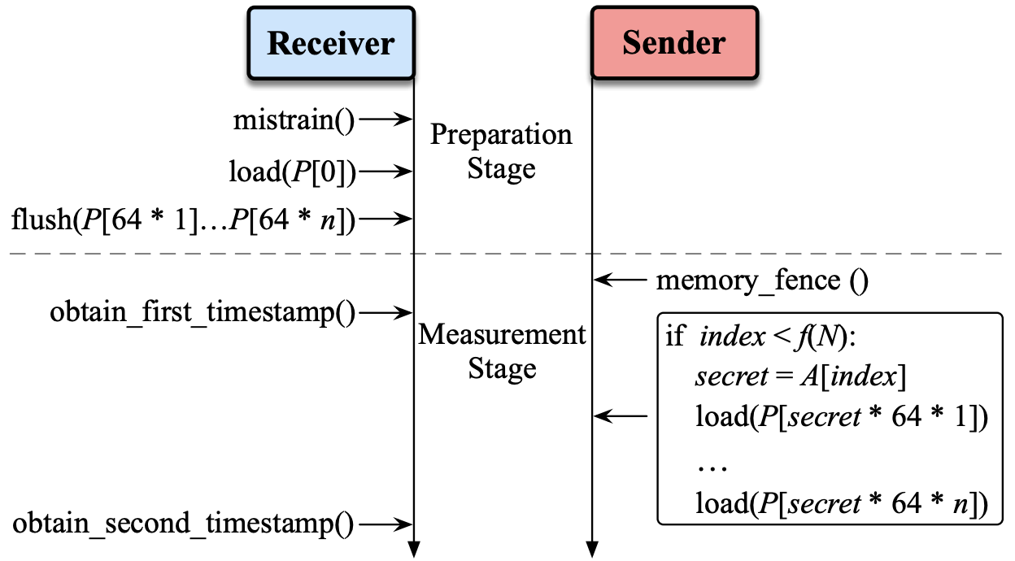
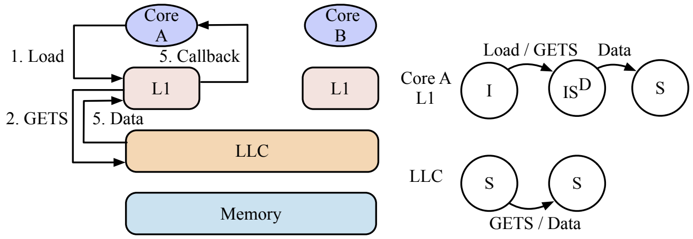
WOW
unXpec
HPCA 2022
ZJU’s first HPCA paper
SwiftDir
MICRO 2022
ZJU’s first MICRO paper(s)

Slide 128
More than that?
Notes:
But what’s more than that is if you really go deep into the research practice,

Slide 129
learn to learn things differently
Notes:
You’ll learn to learn things differently

Slide 130
know not only how but also why and why not
Notes:
You’ll start paying attention to not only how something works but also why it works in that way.
You may also start wondering why it doesn’t work in some other ways.

Slide 131
read this book and you’ll see Operating Systems: Three Easy Pieces http://pages.cs.wisc.edu/~remzi/OSTEP/
Notes:
Again, I’m recommending the book Operating Systems: three easy pieces;
It’ll help to shape your research mind as well as build background knowledge for computer architecture.

Slide 132
Grade?
Notes:
Finally, the part you care the most,

Slide 133
Grading (tentative)
4% | Class Participation & Performance
16% | Assignment
8% | Quiz
32% | Lab OR Research
40% | Final Exam closed-book + memo 10:30 – 12:30, January 03, 2023
Notes:
Grading policy
Now we’ve talked about several components this course requires, here’s how they contribute to the final grade.

Slide 134
How will I teach?
Notes:
Then, how will I teach?

Slide 135
What Students Expect from Teachers
Fun
Humor
Expertise
Easy exam
High grades
…
Notes:
For most of us, an ideal teacher should be fun and humorous, meanwhile, he or she should be an expert for what is taught.
More important, exams should be easy and grades should be high.

Slide 136

I wish I knew someone like this, too…
Notes:
Well, you can’t always get what u want, right?

Slide 137
Teaching Plan
Keep it Simple
Focus on the core concepts
Try to help you more easily understand
Notes:
So here’s how I teach.
As a junior faculty member, I’m gradually getting familiar with what I teach as well.
For every teaching component, I’ll try to keep it simple and focus on the core concepts. The ultimate goal of my teaching is to help you more easily understand what the textbook delivers.

Slide 138
more and more examples
in lectures and discussions
Notes:
For ease of understanding concepts and principles

Slide 139
more and more examples
in lectures and discussions

Slide 140
questions
more and more examples
in lectures and discussions
Notes:
For ease of understanding how to solve related questions

Slide 141
questions
more and more examples
in recitations

Slide 142
Learn, Teach, Inspire
Teach to Learn: A Privilege of Junior Faculty
“If we can contribute, in whatever way,
to a student’s pursuit of a better self,
even if it is not about the course per se,
we still succeed as educators.”

Slide 143
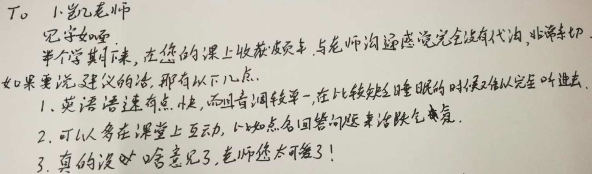
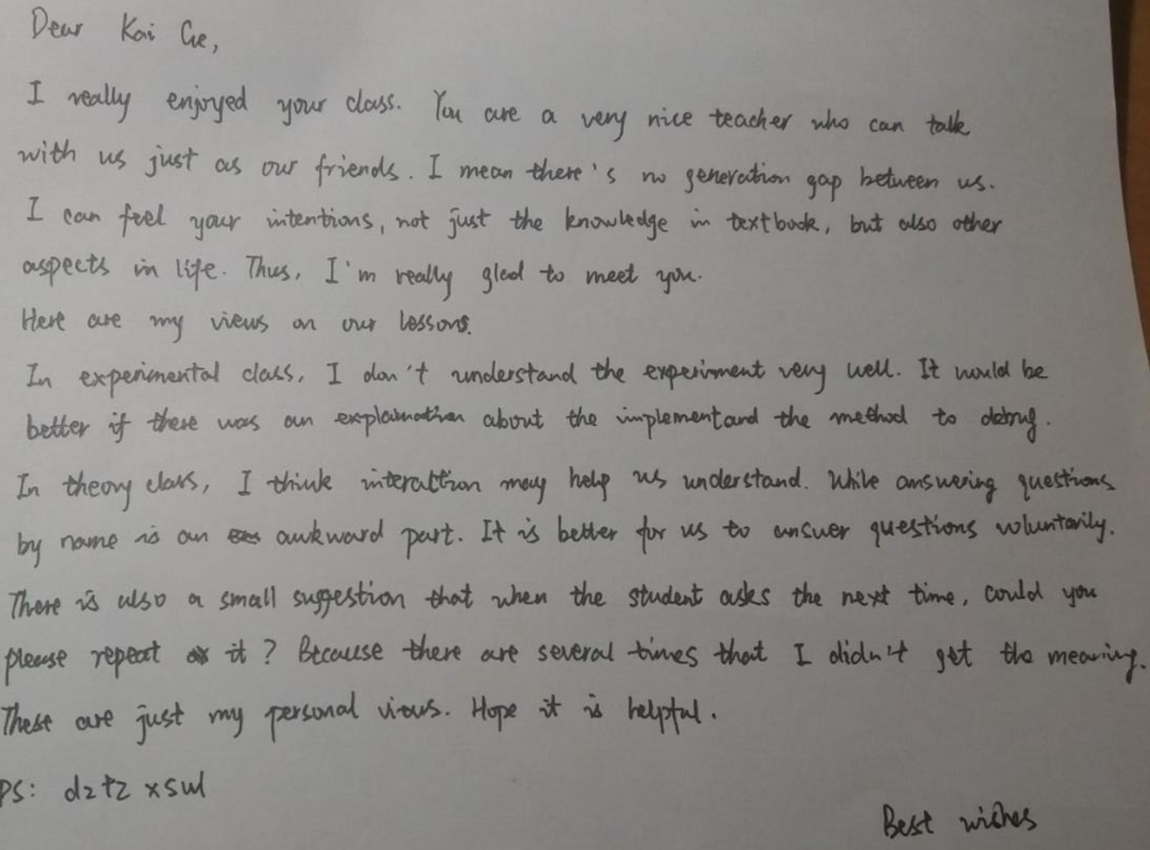
Rumor Has It?
find out more from
Q11.pdf

Slide 144
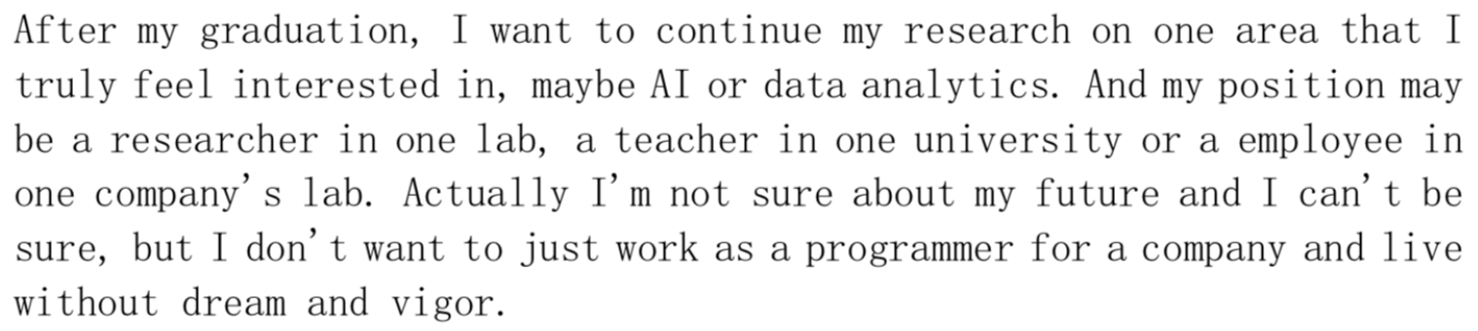
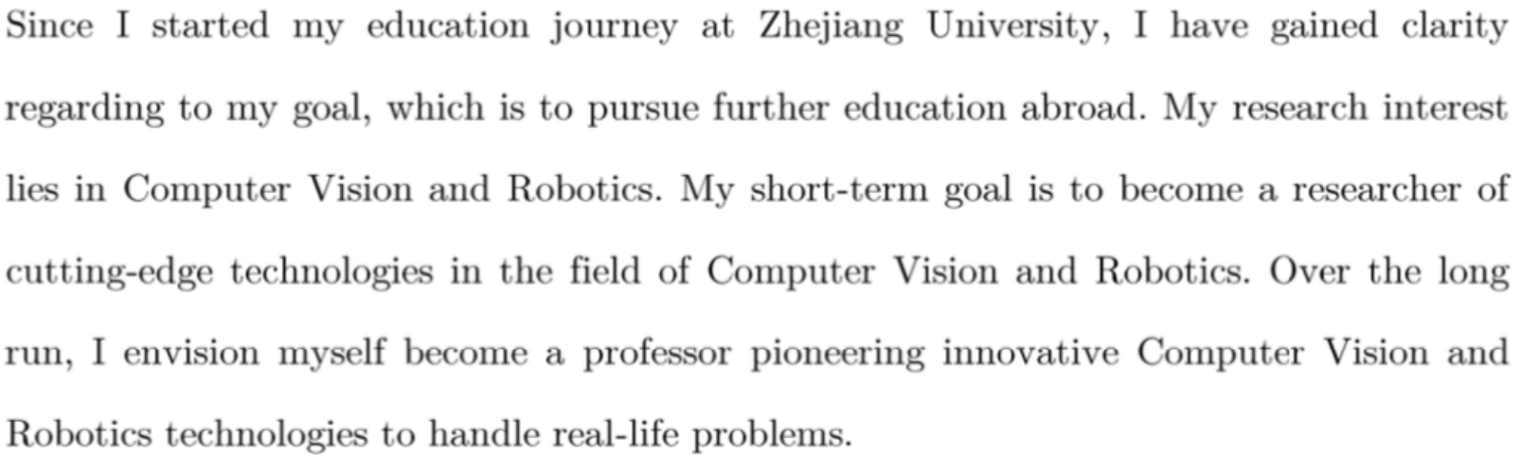
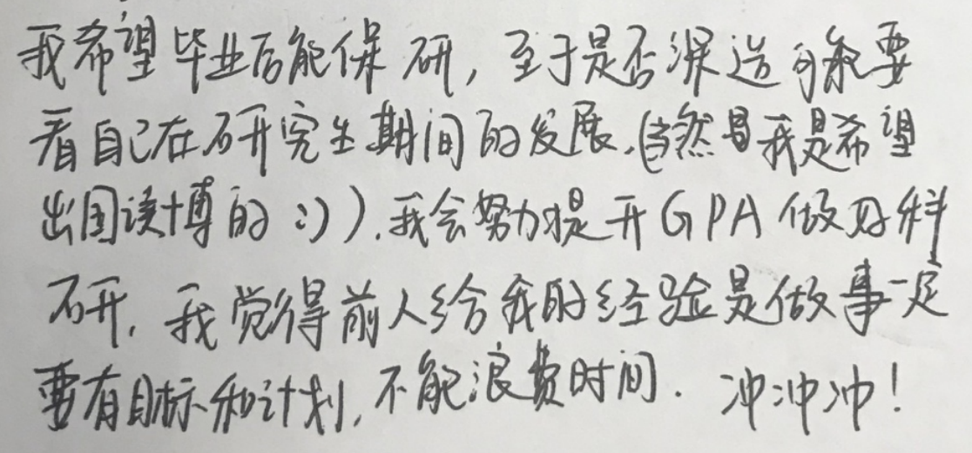
To Every One of A Kind
find out more from
Q11.pdf 2nd edition
Notes:
Also value students’ goals and strengths, and try to help them if possible…;

Slide 145
of millions of advice you’ve been told

Slide 146
the one I prefer is enjoy being you

Slide 147
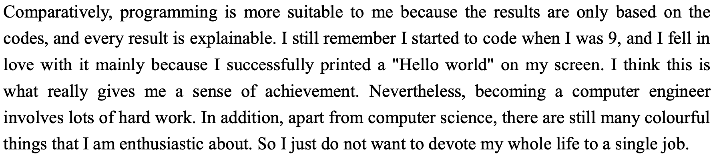

Enjoy Being You
find out more from
Q25.pdf 3rd edition

Slide 148

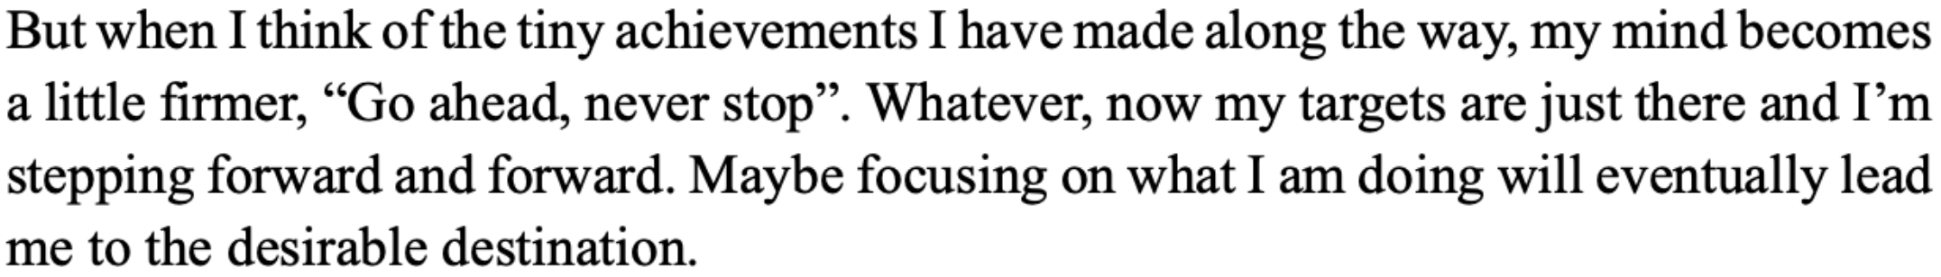
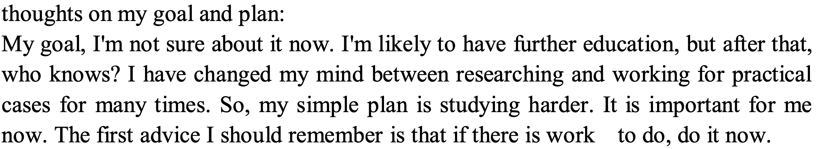
Shine Your Way
find out more from
Q25.pdf 4th edition

Slide 149
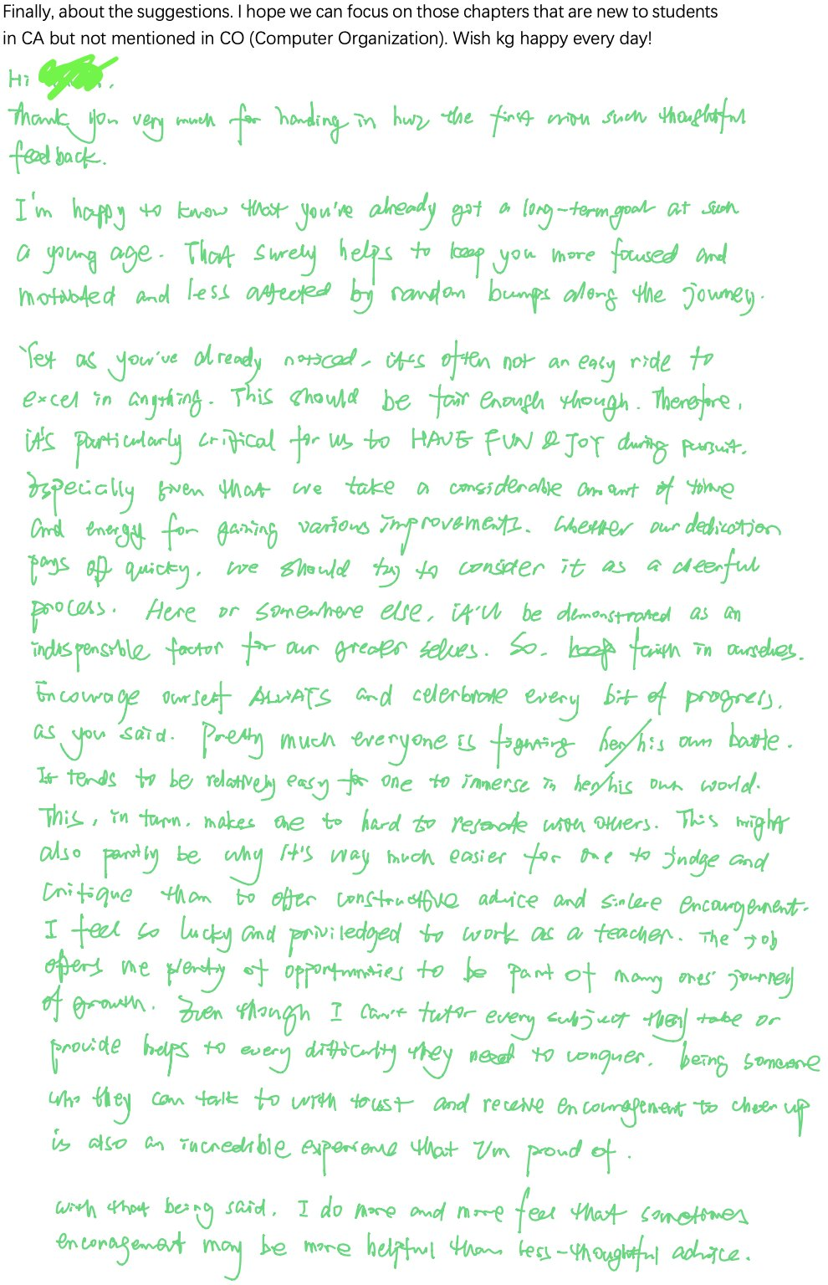
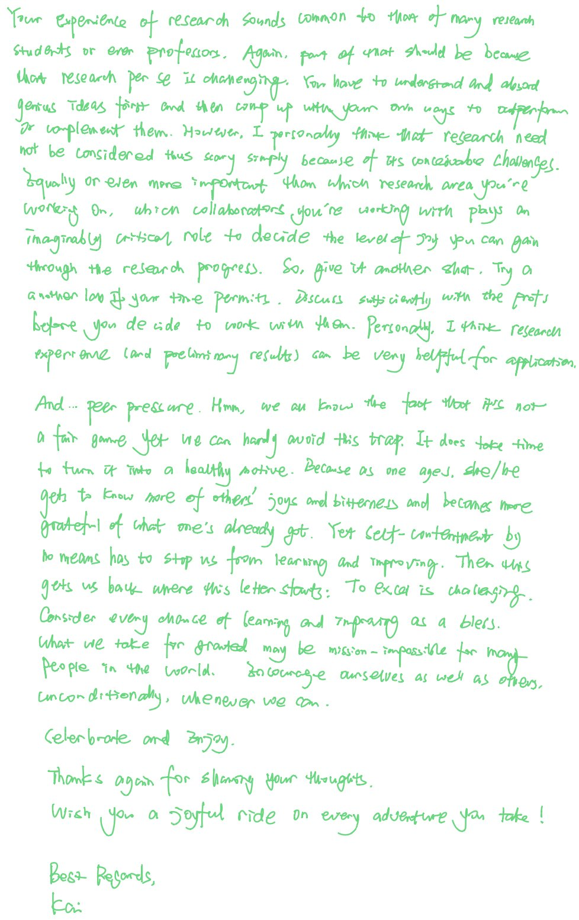

Slide 150
#What’s More to Share
helpful/inspiring resources
#The 3 Secrets of Highly Successful Graduates by Reid Hoffman
Notes:
I’ll also share with you some helpful or inspiring videos and articles.

Slide 151
How will you contribute?
Notes:
Besides my efforts, your contributions are also indispensible.

Slide 152
Thanks In Advance
Study group
Lab assistants
Research interns
…
AT LEAST
submit assignments & lab reports
show up to final exam
Notes:
For example, you can start study groups for peer discussion, you can help me as lab assistants or research interns.
At least, please submit assignments in time and show up to final exam.
Believe it or not, some students just don’t.

Slide 153
Enjoy, xixi
Notes:
Hope you’ll enjoy

Slide 154
Deal?

Slide 155
QQ Group: 533944879
Notes:
One more request, join this qq group for ease of off-line discussion.

Slide 156

WOW, Member #300
Notes:
17

Slide 157
WOW, Member #400
Notes:
18

Slide 158
WOW, Member #500
Notes:
19

Slide 159
WOW, Member #600
Notes:
19

Slide 160
WOW, Member #666
Notes:
20

Slide 161
?
Notes:
So far, we have introduced course logistics and contents.
Any questions?

Slide 162






























Notes:
wow，祝满绩，xixi
Goal: learn with fun

Slide 163
Thank You
wish you health & safety
Notes:
Hope you just had a joyful holiday season.
At the very beginning of this course, let me sincerely thank you for studying Computer Architecture with me.

Slide 164

Who’s Who
Notes:
Roster;
Now it’s time for the class to get the first impression of each of you.
Briefly introduce yourself if you like when I call ur name; you could use either English or Chinese.

Slide 165
Ready?
Notes:
Great to know u all,
Now, Ready for an adventure to computer architecture?

Slide 166

#The 3 Secrets of Highly Successful Graduates
Notes:
Cause if not now, when?

